Slide 1
Sitemap & Web Content Mibrand
(I.)
(II.)
(III.)
(IV.)
(V.)
(VI.)
(VII.)
(VIII.)
Home
Mibrand Vietnam
Portfolio
Products & Services
We Share
Brand Finance
Careers
Contact
(4.1)
(2.1)
Mibrand Vietnam
Brand Consulting Service
Brand Knowledge
(5.1)
(2.2)
MVV Group
Brand Spice of Life
(5.2)
(2.3)
Our Expert

Slide 2
I. Home

Slide 3
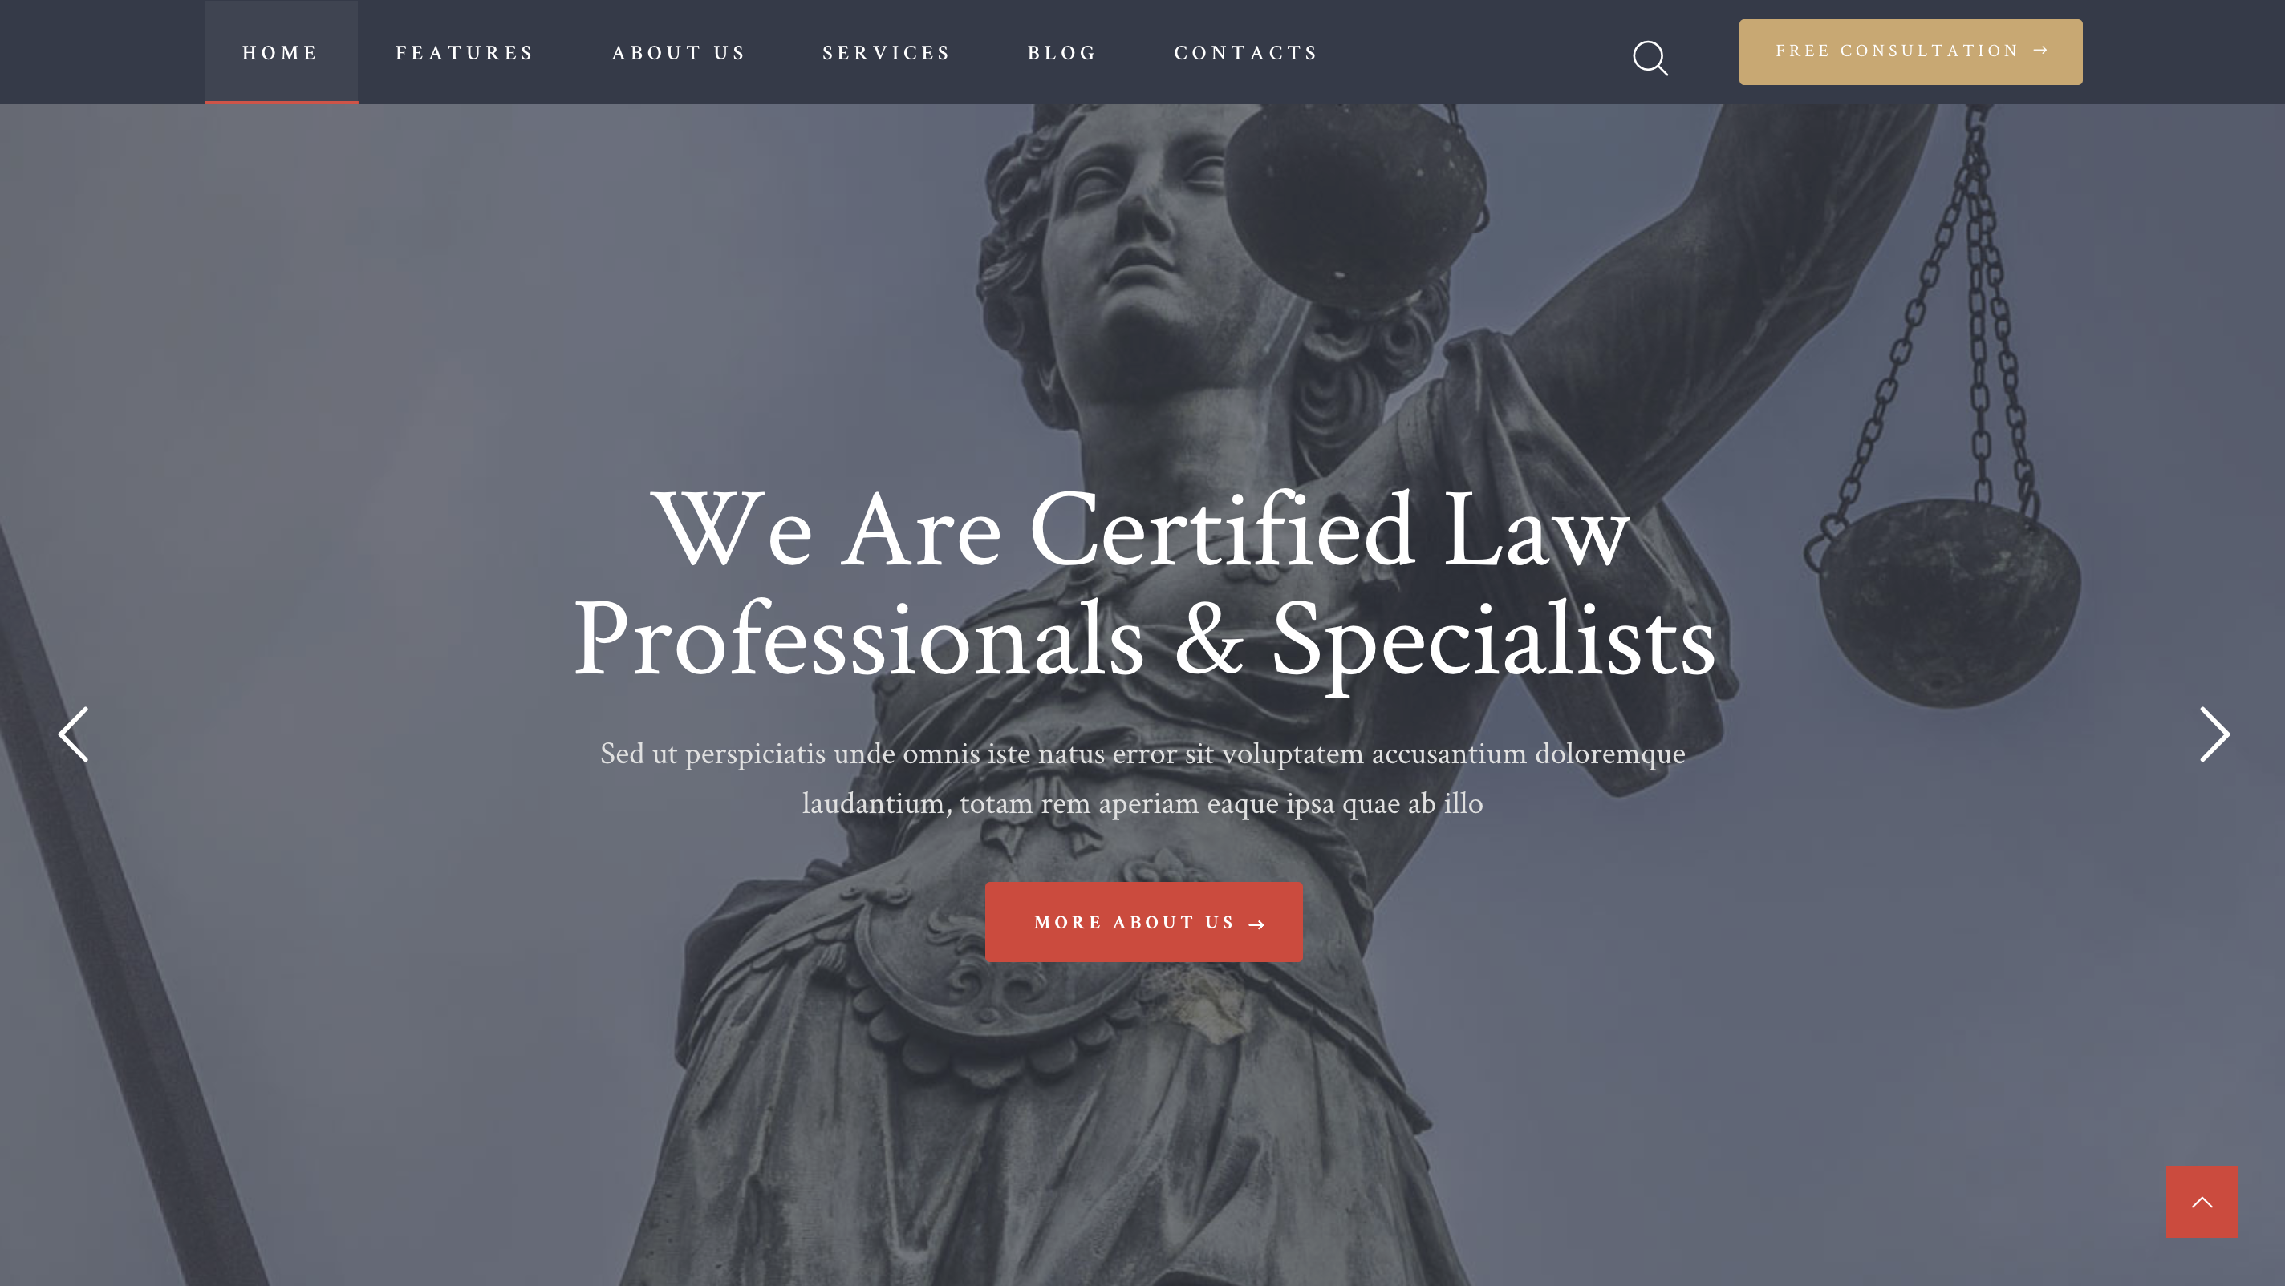
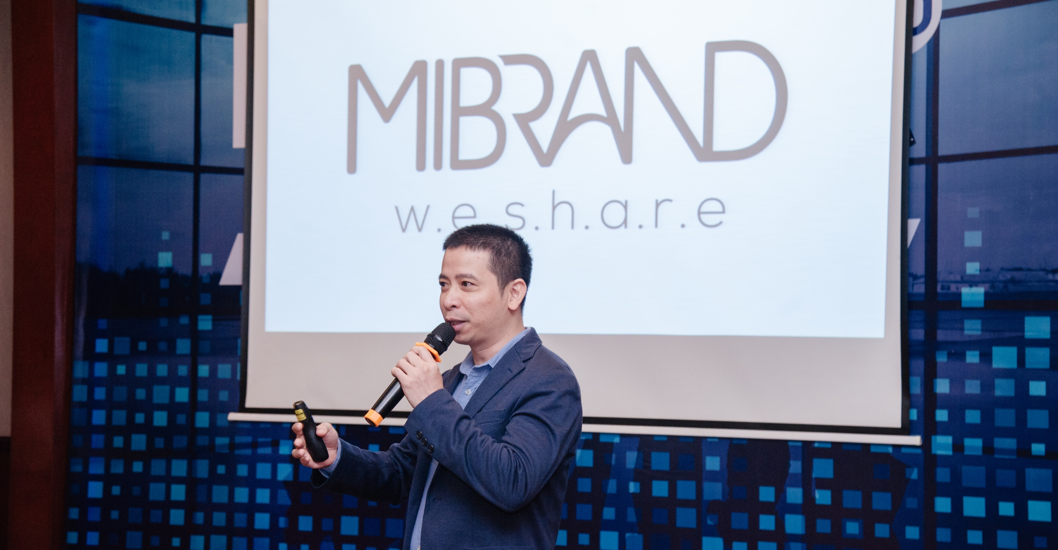
MIBRAND
VIETNAM
BRAND FINANCE
CONTACT
GIỚI THIỆU VỀ MIBRAND
PORTFOLIO
WHAT WE DO
WE SHARE
CAREERS
MIBRAND VIETNAM
MVV GROUP
OUR EXPERTS
SERVICES
PRODUCTS
BRAND KNOWLEDGE
THE SPICE
OF BRAND LIFE
BRAND FINANCE
BRAND VALUATION
TOP 50 VIETNAM BRAND REPORT
We develop Brand strategy along with Your Business Strategy
With Mibrand’s approach, eveyone in your organization can become a Brand Expert
MORE ABOUT US
(Button) Về Mibrand Vietnam > Link dẫn về 2.1

Slide 4

MIBRAND
VIETNAM
BRAND FINANCE
CONTACT
PORTFOLIO
WHAT WE DO
WE SHARE
CAREERS
CONTACT US
Our mission is to help our customers increase their brand equity in a sustainable way
We measure success in our work by enhancing the brand value of our customers
OUR SUCCESS STORY
(Button) Các câu chuyện thành công của chúng tôi > Link dẫn về II.

Slide 5
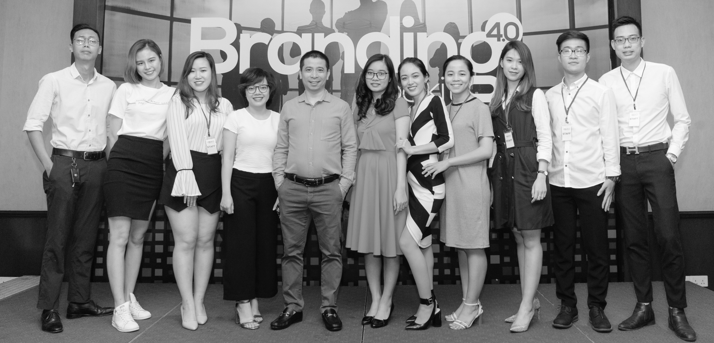
MIBRAND
VIETNAM
BRAND FINANCE
CAREERS
CONTACT
PORTFOLIO
WHAT WE DO
WE SHARE
CONTACT US
We share the knowledge that helps you become a brand expert
After nearly 20 years of consulting and supporting Vietnamese businesses in branding, we draw the most valuable lessons to share with you and make you growth your expertise.
WE SHARE
(Button) We Share > Link dẫn về V.

Slide 6
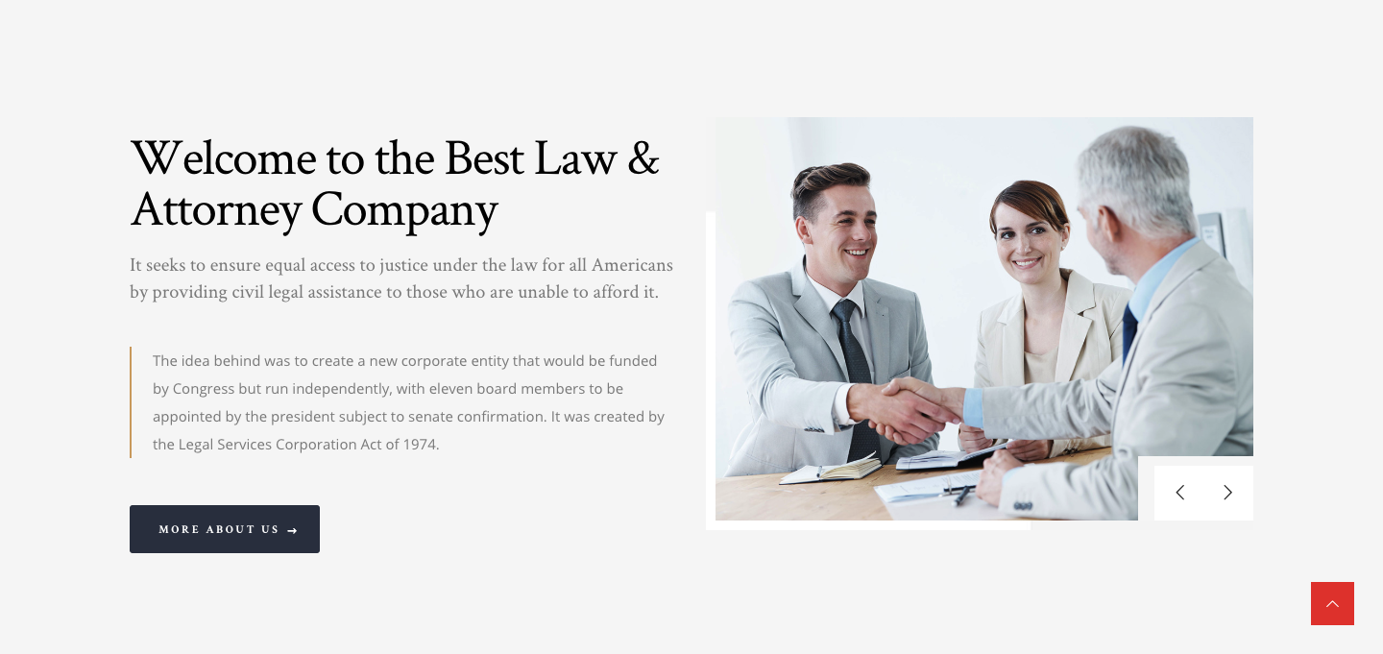

Brand Strategy Consultant in Vietnam
Mibrand Vietnam helps to increase brand value, measure and monitor the success of your business
We are the first brand consulting company in Vietnam that bring the concept of measurement of enterprises’ intangible assets through brand valuation. We are here to share, inspire and help businesses increase their brand value in a sustainable way
Mibrand Vietnam
(Button) Về Mibrand Vietnam > Link dẫn về 2.1.

Slide 7

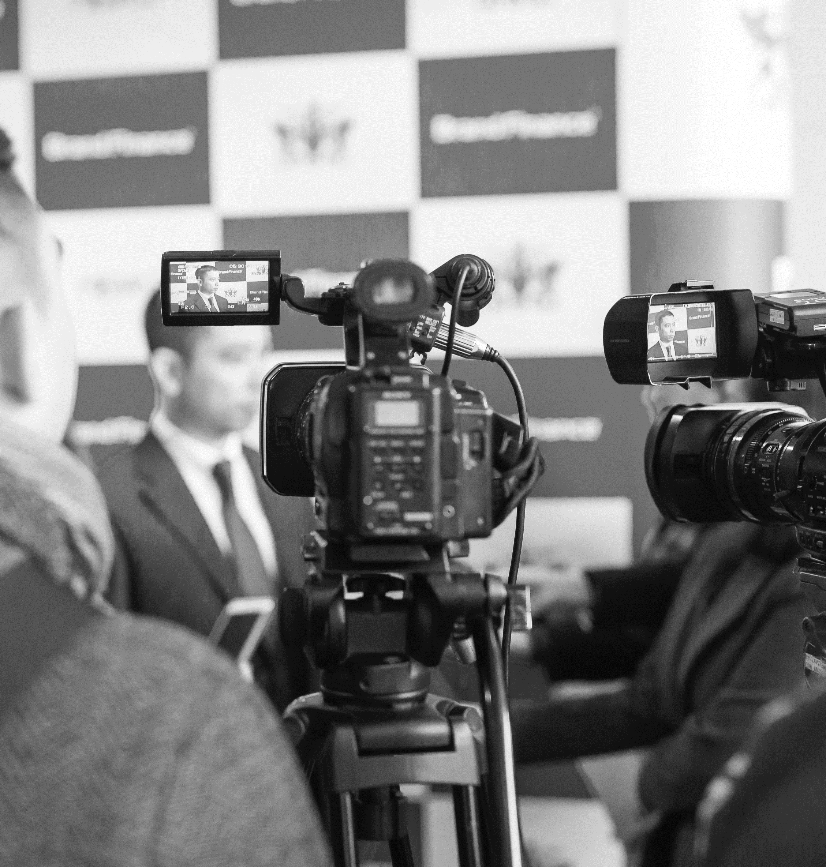

OUR ACHIEVEMENTS IN THE FIELD OF BRAND CONSULTING
We are not just a consultancy, we work with our customers to search for optimal business solutions and market potential and open up new opportunities for the brand to enhance sustainable value for businesses.
200+
100+
20+
18+
Consulting Workshops
Domestic and international customers
Industries & Categories
Brand Consultant Experts in Vietnam
(Button) Hồ sơ năng lực của chúng tôi > Link dẫn về III.

Slide 8
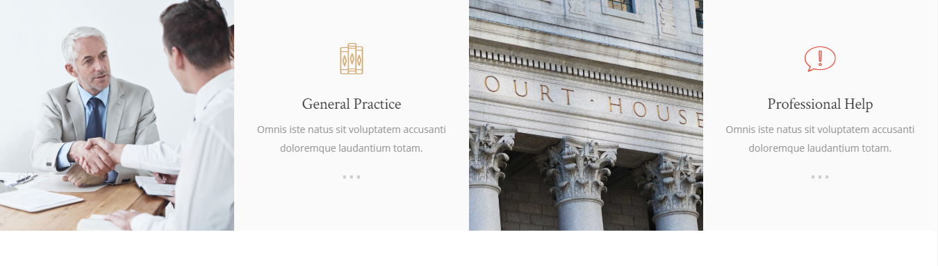

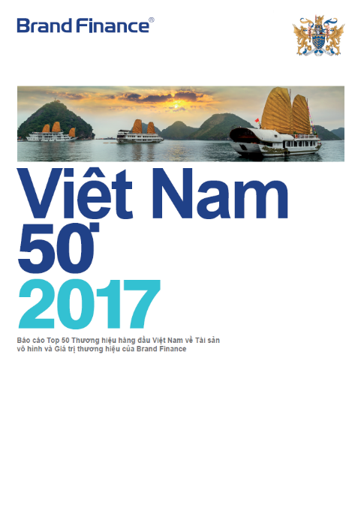


Member of Media Ventures Vietnam Group
Strategic partnership with Brand Finance
MVV Group brings together over 200 experienced, knowledgeable and passionate consultants in the fields of Branding, Advertising, Media, Product Design, Film Production, Digital Marketing Content creative, technology
...
Frequently Asked Questions
Mibrand is the official partner and representative in Vietnam of Brand Finance (UK) - one of the three biggest company offer Brand Valuation service in the world
...
(Button)
1 – Thành viên của Media Venture Vietnam Group > Link dẫn về 2.2
2 – Đối tác chiến lược với Brand Finance > Link dẫn về 6.1

Slide 9
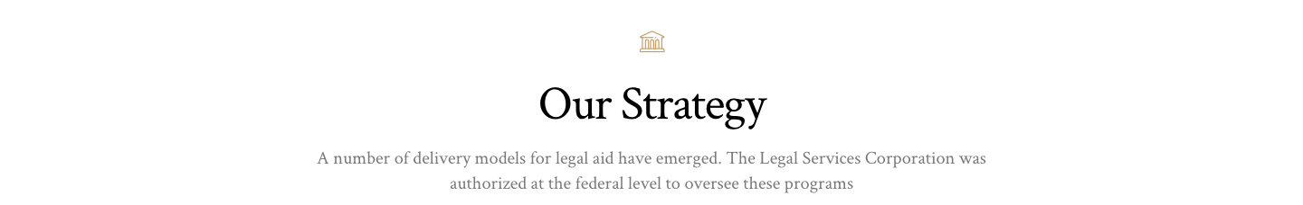
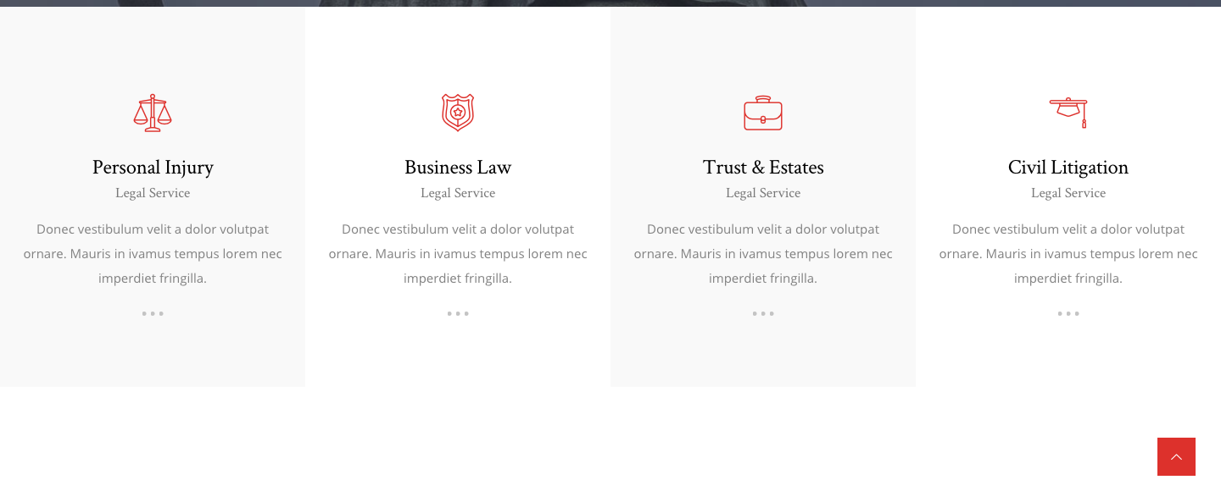




Our Key Products & Services
Our specialized services and products are based on the belief that “BRAND-DRIVEN BUSINESS” is the solution helps businesses build a sustainable competitive advantage in the market.
Brand Strategy
Consultancy & Implementation
Brand & Marketing Communication Consultancy
Brand Measurement & Market Research
Branding Toolkits
Our key services
Our key services
Our key services
Our key products
Our work helps clients to increase their brand value by integrating brand strategy into their business strategy.
With leading experts in the field of marketing - communication consultancy, we have developed some effective campaigns for many local and international clients
We provide research, survey, and data analysis services suitable for individuals and businesses wishing to research in the areas of branding, marketing, communications and human resource management
After nearly 20 years of experience in consulting and supporting companies in Vietnam, we draw the most valuable lessons to build our exclusive branding tools. These tools will help business leaders build their own brand strategies - one of the hardest jobs businesses face without the help of agencies.
(Button)
Tư vấn & Thực thi chiến lược Thương hiệu > Link dẫn về 4.1
Tư vấn kế hoạch tiếp thị - truyền thông thương hiệu > Link dẫn về 4.1
Nghiên cứu thị trường & Đo lường thương hiệu > Link dẫn về 4.1
Các công cụ xây dựng & quản trị thương hiệu > Link dẫn về IV

Slide 10
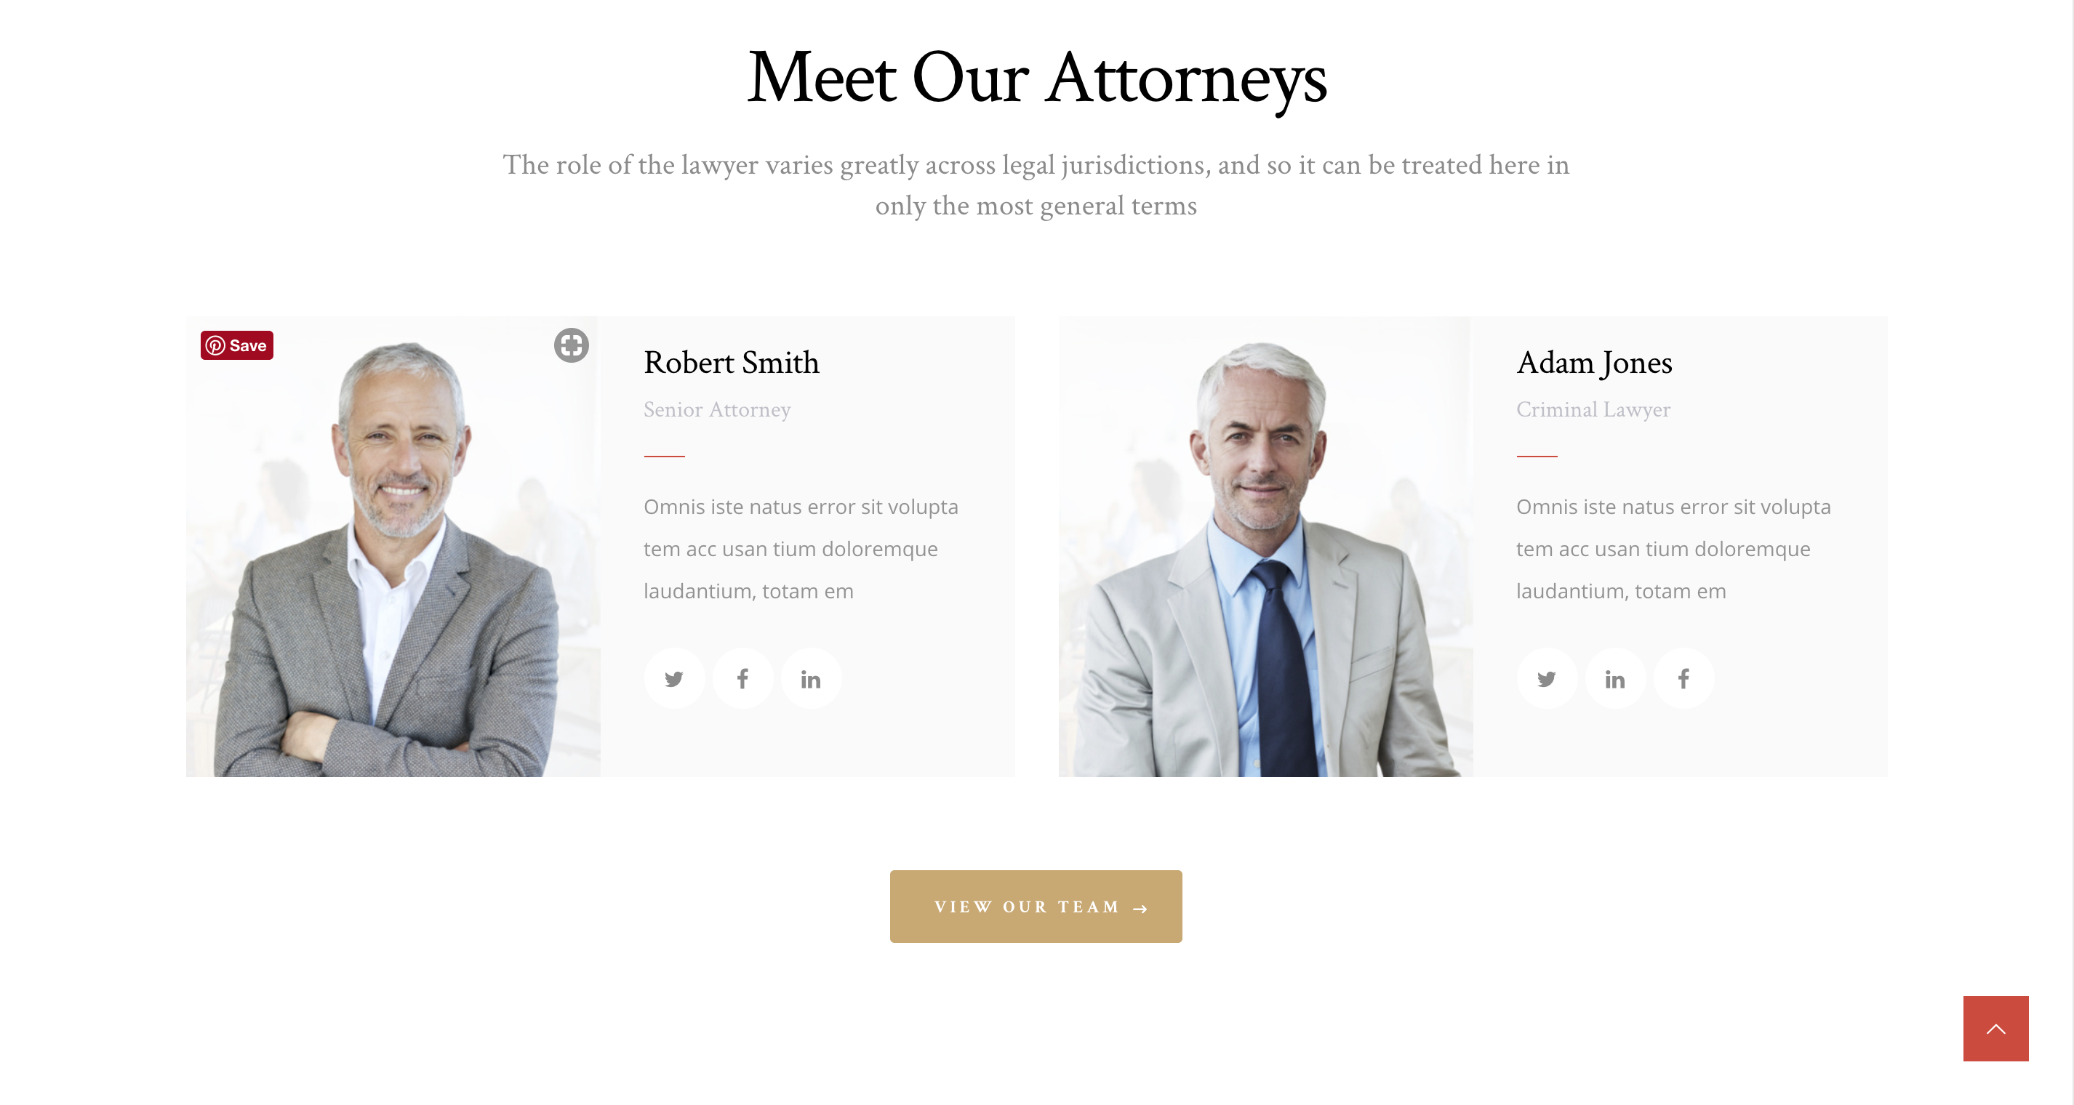
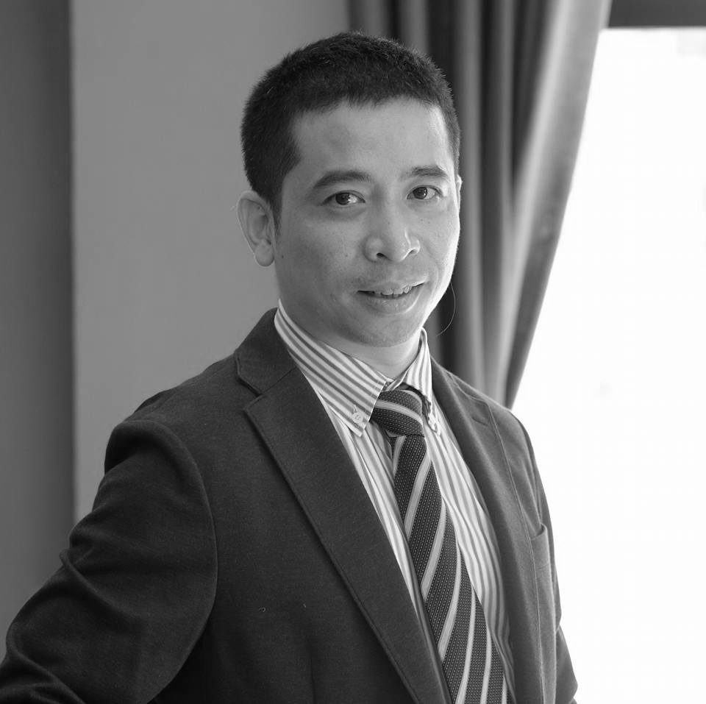
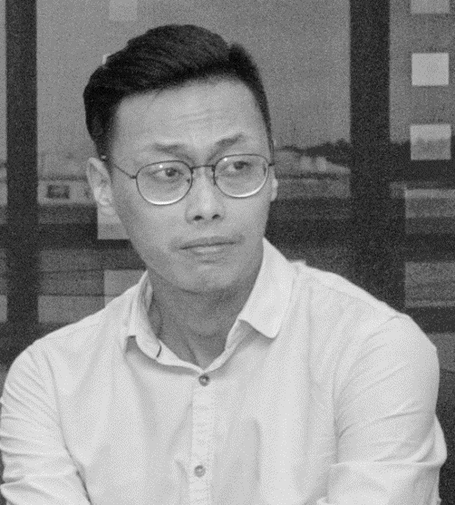
Our experts
With a team of experienced experts in the field of brand consulting and marketing - media master, Mibrand Vietnam is committed to accompany customers on all stages of the brand.
HD Bank
Chiến lược định vị & phát triển thương hiệu HD Bank
Mr. Lại Tiến Mạnh
Mr. Phùng Thái Dương
Managing Director
Deputy Director | Brand Consultant
Mr. Manh is a senior consultant in business solutions, marketing and branding.
He established Mibrand Vietnam Joint Stock Company with the ambition to become the leading brand consultancy company in Vietnam.
Mr. Dương is now a Deputy Director of brand strategy consulting at Mibrand.
With extensive experience in the field of branding, Duong is currently leading the Brand Consultant Team to develop projects for large clients in Mibrand.
GẶP GỠ ĐỌI NGŨ CỦA CHÚNG TÔI
MEET OUR TEAM
(Button) ĐỘI NGŨ CỦA CHÚNG TÔI > Dẫn link đến 2.3

Slide 11

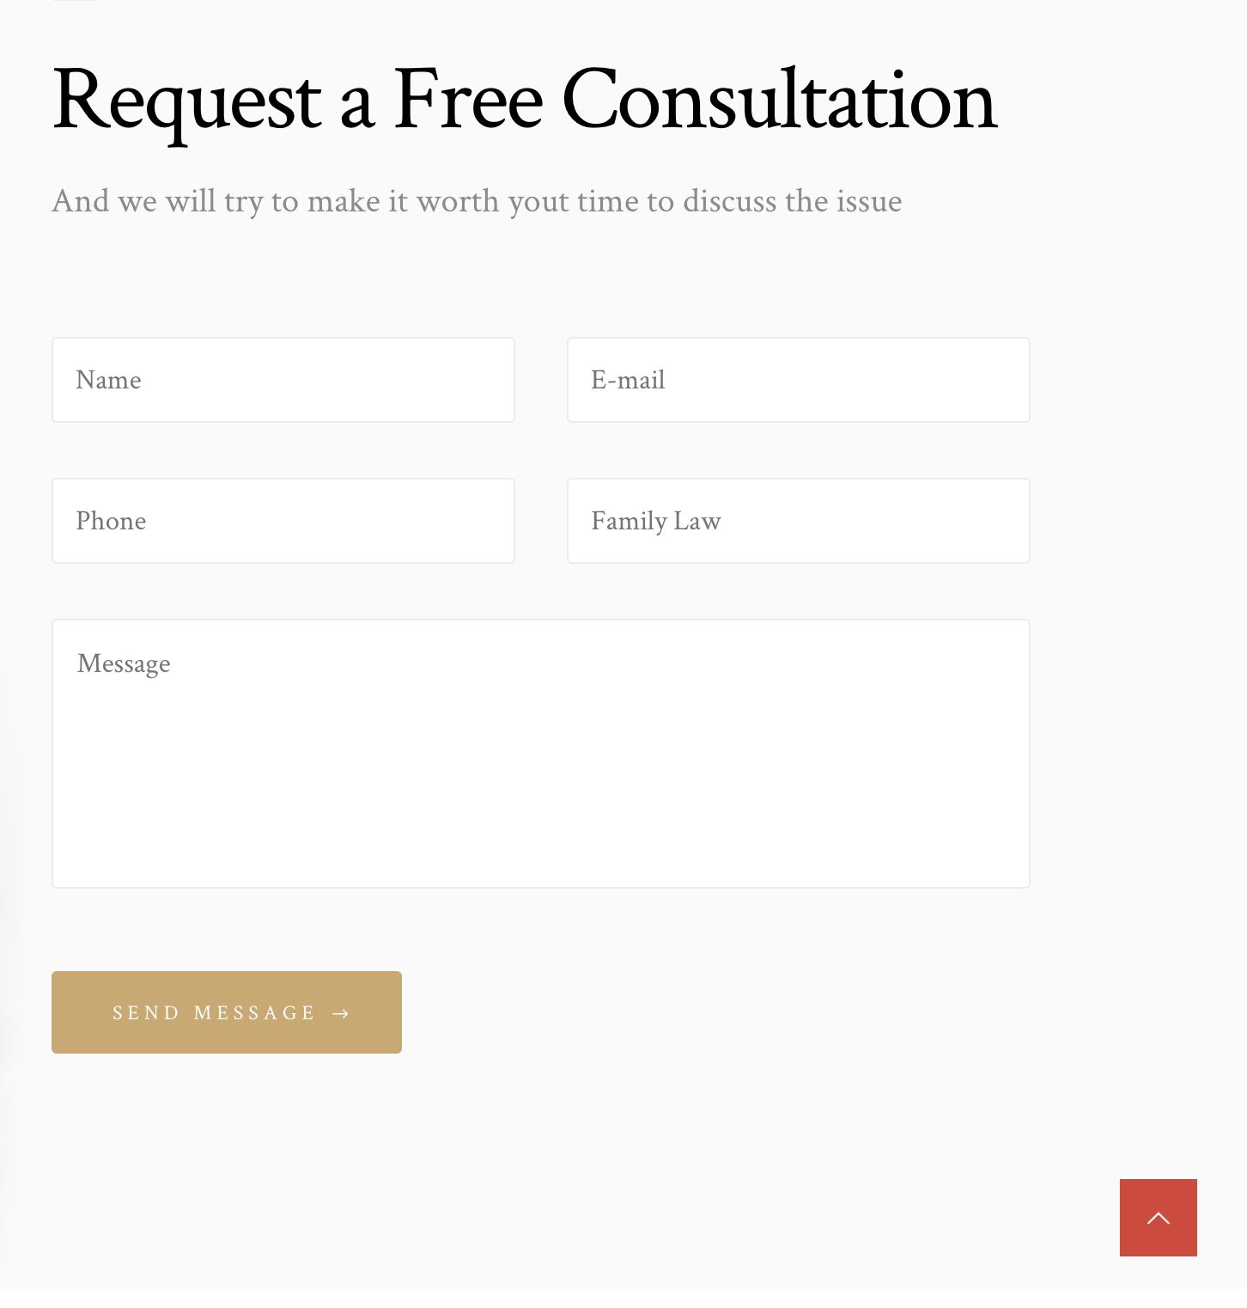
Request a consultation
Mibrand Vietnam will contact you as soon as possible
HD Bank
Chiến lược định vị & phát triển thương hiệu HD Bank
Name:
Email:
Company Name
Tel:
Company name:
Message:
Brand Positioning & Development Stategy
Send message
(Button) GỬI YÊU CẦU > Gửi vào Email: contacus@mibrand.vn

Slide 12
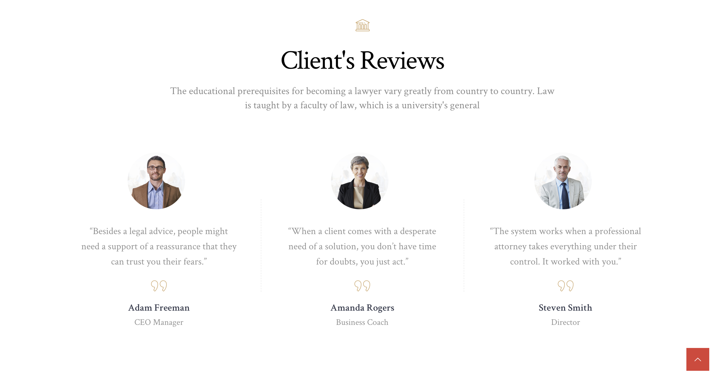

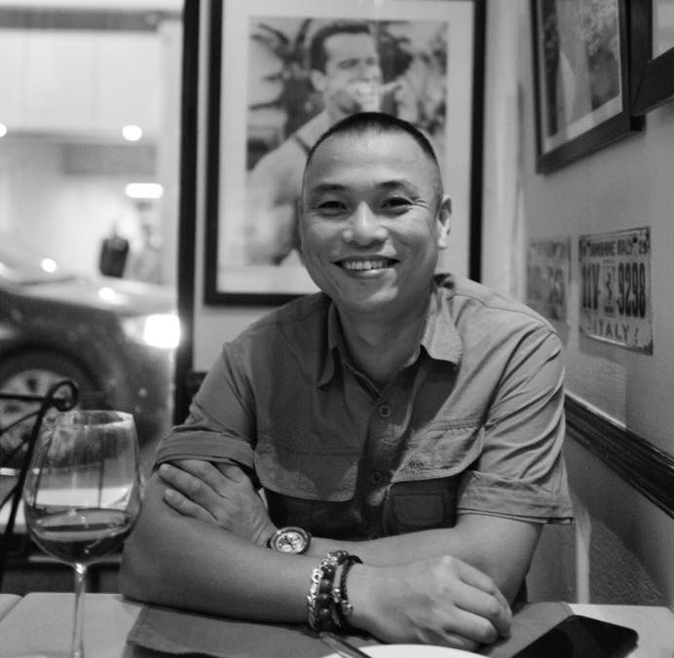
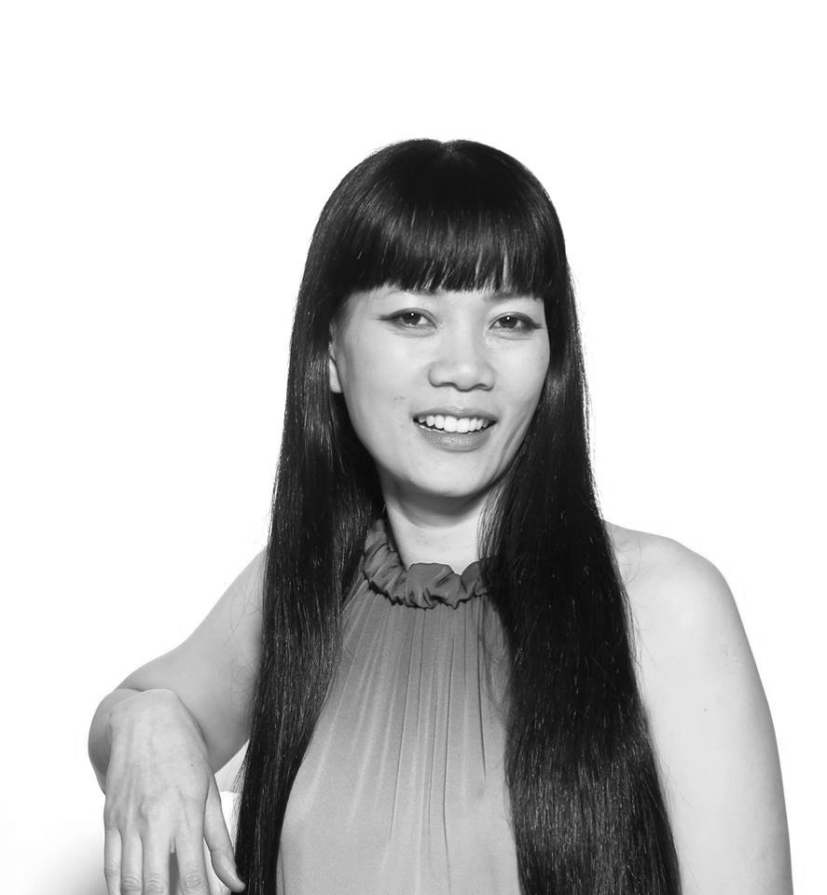
Our reputation is confirmed by the success of the customer
We think Mibrand will be a pioneer in this section to revaluate the brand of any enterprise...
Mibrand and their team of professional consultants pointed out practical issues and gave us the opportunity to look back and identify our position in the market.
We think Mibrand will be a pioneer in the field of consulting and evaluation.
Mibrand Vietnam's brand consulting team has helped us to develop our GPA brand strategy with all our efforts and enthusiasm.
Ms. Nguyen Thu Dung
Mr. Nguyen Viet Thang
Ms. Van Anh
Ms. Dao Thu Hien
Founder & CCO
Đồ trang sức D’Rosie
Vice President of Sales
SaoBacDau Technologies Corporation
Founder & CEO
Golden Path Academics

Slide 13
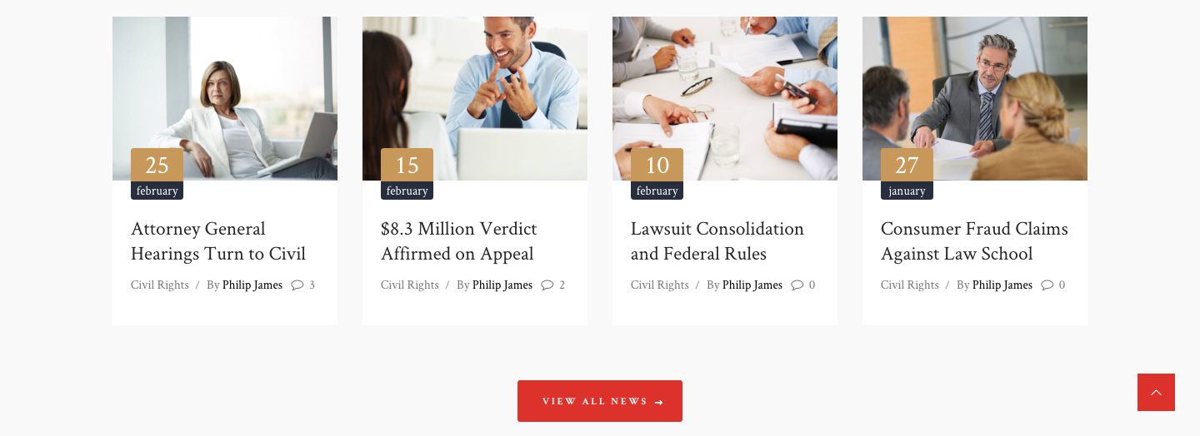

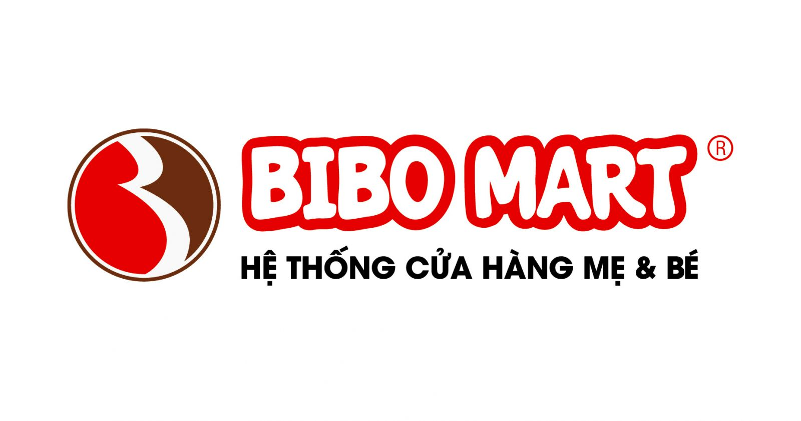



We Share
Helping and sharing knowledge about Brand is our Source of Life
See more post
(Button) XEM CÁC BÀI VIẾT KHÁC > Dẫn link đến V.

Slide 14







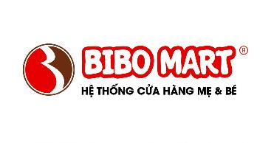


















Slide 15
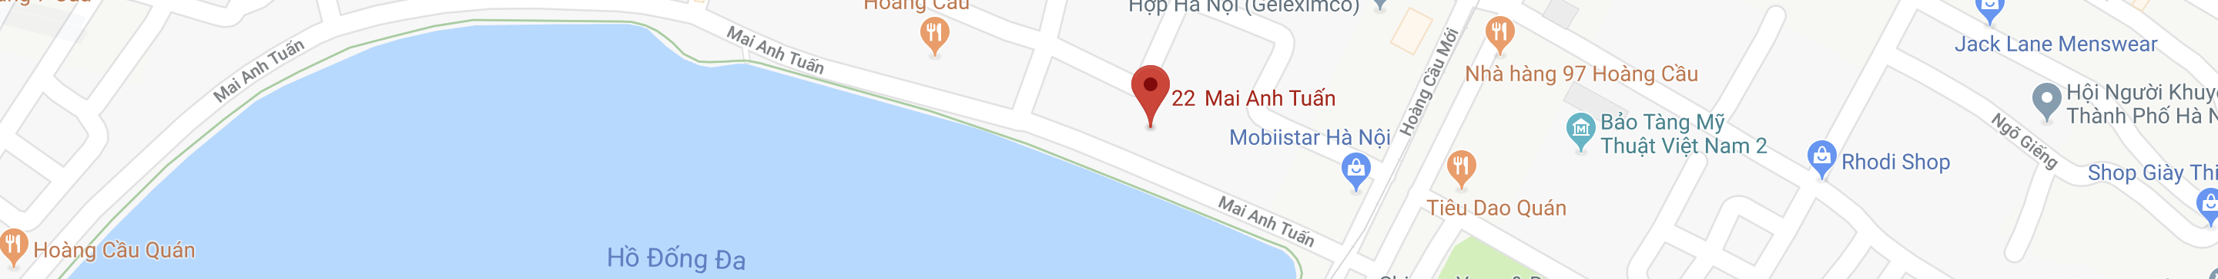
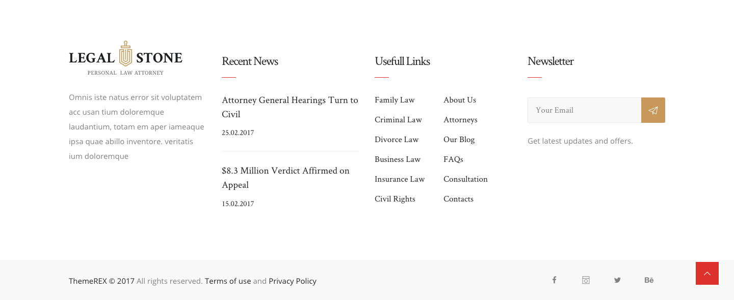

We Share
Home
Mibrand Vietnam
Portfolio
Services & Products
We Share
Brand Finance
Contact
We are not just a consulting company, we help find the best solutions to enhance your brand value.
Vui lòng để lại Email của bạn để nhận các thông tin và ưu đãi mới nhất từ Mibrand Vietnam.

Slide 16
II. Mibrand
Vietnam

Slide 17

MIBRAND
VIETNAM
SERVICES & PRODUCTS
BRAND FINANCE
CONTACT
GIỚI THIỆU VỀ MIBRAND
PORTFOLIO
WE SHARE
CARREERS
MIBRAND VIETNAM
MVV GROUP
OUR EXPERTS
We are Mibrand Vietnam
About us / About MVV Group / Meet our team
(03 Button)
Giới thiệu về chúng tôi > Dẫn link đến 2.1
Giới thiệu vê MVV gropup > Dẫn link đến 2.2
Đội ngũ chuyên gia của Mibrand > Dẫn link đến 2.3

Slide 18


Welcome to Mibrand Vietnam
We are one of the first company to set the foundation for the field of Brand Strategy Consulting in Vietnam. We are here to share, inspire and help businesses to increase their value of Brands in a sustainable way.
See more
(Button) Xem thêm > Link dẫn về 2.1

Slide 19

Member of Media Ventures Vietnam Group
26
250+
8
2
Years of experience
Experts
Offices in Hanoi
& Ho Chi Minh city
Offices in Singapore and USA
More about MVV GROUP
(Button) XEM THÊM VỀ MVV GROUP > Link to 2.2

Slide 20
Our experts
With a team of experienced experts in the field of brand consulting and marketing - media master, Mibrand Vietnam is committed to accompany customers on all stages of the brand.
HD Bank
Chiến lược định vị & phát triển thương hiệu HD Bank
Mr. Lại Tiến Mạnh
Mr. Phùng Thái Dương
Managing Director
Deputy Director | Brand Consultant
Mr. Manh is a senior consultant in business solutions, marketing and branding.
He established Mibrand Vietnam Joint Stock Company with the ambition to become the leading brand consultancy company in Vietnam.
Mr. Dương is now a Deputy Director of brand strategy consulting at Mibrand.
With extensive experience in the field of branding, Duong is currently leading the Brand Consultant Team to develop projects for large clients in Mibrand.
Meet our team
MEET OUR TEAM
(Button) ĐỘI NGŨ CỦA CHÚNG TÔI > Dẫn link đến 2.3

Slide 21
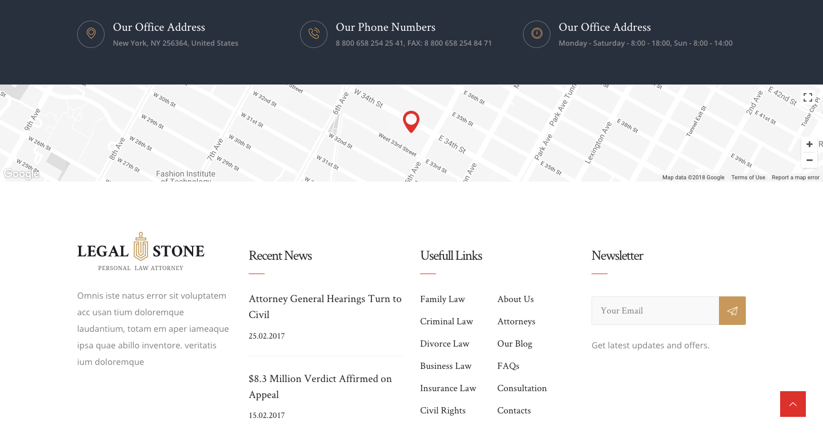
Address:
Telephone:
Working hours:
7th, Prima Building, 22 Mai Anh Tuan, Dong Da dist, Hanoi, Vietnam
(024).7300.5288
Monday – Friday 8:30 – 18:00
We Share
Home
Mibrand Vietnam
Portfolio
Services & Products
We Share
Brand Finance
Contact
We are not just a consulting company, we help find the best solutions to enhance your brand value
Please let us know your email address to receive regular updates from Mibrand Vietnam.
Vui lòng để lại Email của bạn để nhận các thông tin và ưu đãi mới nhất từ Mibrand Vietnam.

Slide 22
2.1 Mibrand Vietnam

Slide 23
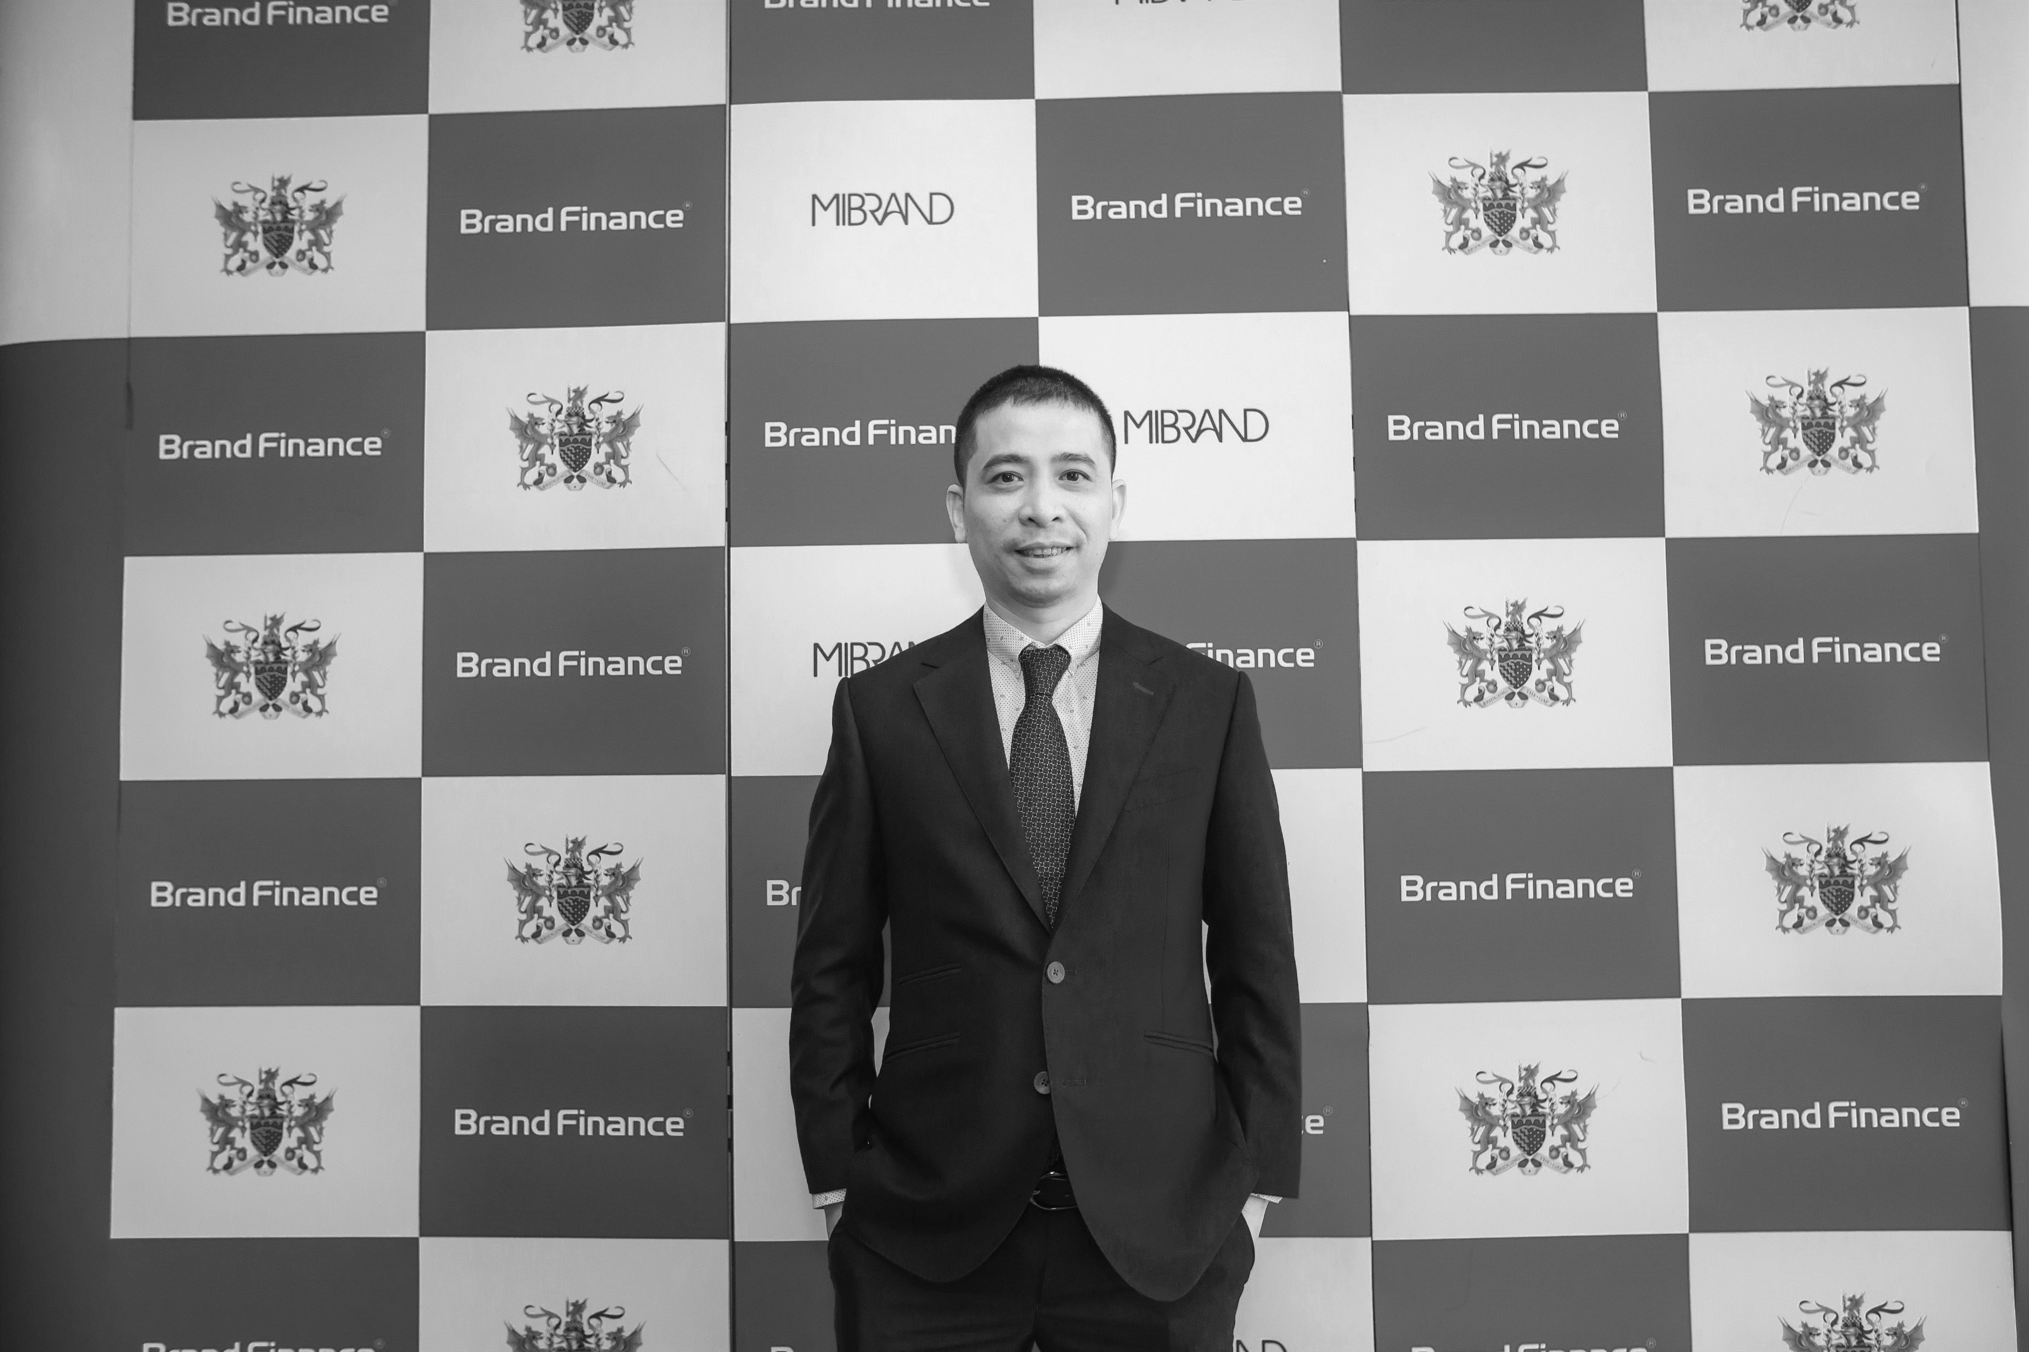
GIỚI THIỆU VỀ
SERVICES & PRODUCTS
BRAND FINANCE
CONTACT
MIBRAND VIETNAM
PORTFOLIO
WE SHARE
CAREERS
We are Mibrand Vietnam
Home / Mibrand Vietnam
Mibrand Vietnam Joint Stock Company
was established in 2004 by Mr. Lai Tien Manh - a specialist in business strategy consulting and branding, having over 20 years experience with major domestic and international clients. Mibrand is one of the member companies of Media Ventures Vietnam (MVV Group) and has been selected as a strategic partner of Brand Finance (One of the three largest brand valuation firms in the world) in Vietnam.
At Mibrand, we develop brand solutions through specific strategies for optimizing business results. Because we believe that brand strategy is also business strategy.

Slide 24
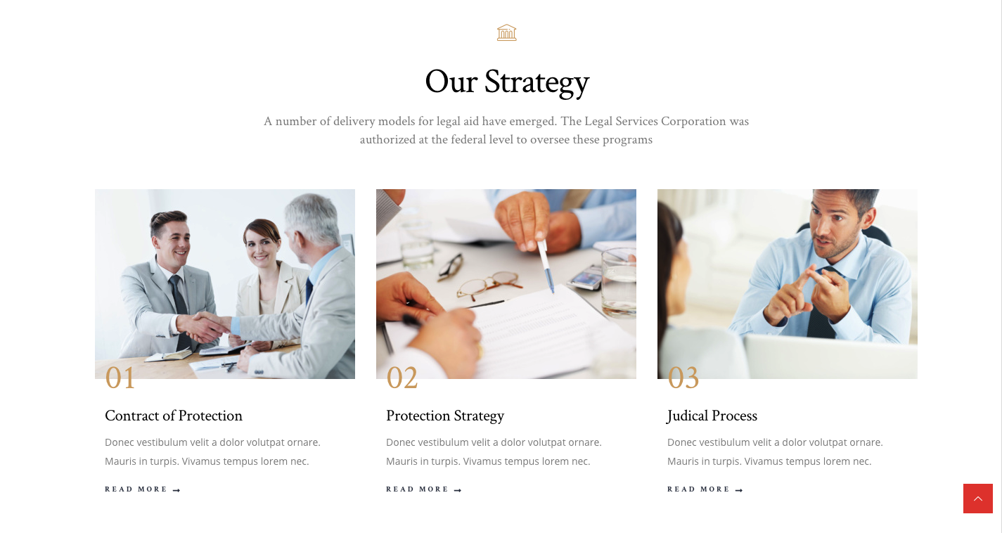



OUR MISSION
Mission of Mibrand Vietnam is to help brand become the driving force in all business activities. We believe that ”Brand-oriented business" is the solution to help businesses build sustainable competitive advantage in the market.
01
02
03
Pioneering
Simplicity
Sharing
Chúng tôi liên tục cải tiến ra các sản phẩm, dịch vụ của mình để hướng đến việc đi tiên phong trong ngành tư vấn xây dựng & quản trị thương hiệu tại Việt Nam.
We are the pioneer in the industry by continuously innovating and improving products / tools that help build and manage brands.
We develop unique, individual brand solutions and maximize simplicity to serve our long-term business strategies.
At Mibrand Vietnam, we believe that experiences and knowledge are only valuable when they are shared with everyone.
(Button) > Dẫn link đến 4.2
(Button) > Dẫn link đến 4.1
(Button) > Dẫn link đến 5.1

Slide 25
OUR ACHIEVEMENTS IN THE FIELD OF BRAND CONSULTING
We are not just a consultancy, we work with our customers to search for optimal business solutions and market potential and open up new opportunities for the brand to enhance sustainable value for businesses.
200+
100+
20+
18+
Consulting Workshops
Domestic and international customers
Industries & Categories
Brand Consultant Experts in Vietnam
(Button) Hồ sơ năng lực của chúng tôi > Link dẫn về III.

Slide 26
Client’s review
Khách hàng nói gì về chúng tôi?
Our reputation is confirmed by the success of the customer
Danh tiếng của chúng tôi được xây dựng dựa trên sự thành công từ các khách hàng
We think Mibrand will be a pioneer in this section to revaluate the brand of any enterprise...
Mibrand and their team of professional consultants pointed out practical issues and gave us the opportunity to look back and identify our position in the market.
We think Mibrand will be a pioneer in the field of consulting and evaluation.
Mibrand Vietnam's brand consulting team has helped us to develop our GPA brand strategy with all our efforts and enthusiasm.
We think Mibrand will be a pioneer in this section to revaluate the brand of any enterprise...
Mibrand và đội ngũ chuyên gia tư vấn chuyên nghiệp của họ đã đưa ra những vấn đề thiết thực cho chúng tôi cơ hội nhìn nhận lại và tìm thấy vị thế của mình trên thị trường
Chúng tôi nghĩ Mibrand sẽ là một trong những công ty đi tiên phong trong lĩnh vực này để tư vấn, đo lường và định giá bất kỳ doanh nghiệp nào.
Đội ngũ tư vấn thương hiệu Mibrand Vietnam đã giúp chúng tôi phát triển chiến lược thương hiệu GPA với tất cả sự nỗ lực và nhiệt huyết của họ.
Ms. Nguyen Thu Dung
Mr. Nguyen Viet Thang
Ms. Van Anh
Ms. Dao Thu Hien
Ms. Van Anh
Ms. Nguyen Thu Dung
Mr. Nguyen Viet Thang
Founder & CEO
Golden Path Academics
Founder & CCO
Đồ trang sức D’Rosie
Vice President of Sales
SaoBacDau Technologies Corporation
Ms. Dao Thu Hien

Slide 27
Address:
Telephone:
Working hours:
7th, Prima Building, 22 Mai Anh Tuan, Dong Da dist, Hanoi, Vietnam
(024).7300.5288
Monday – Friday 8:30 – 18:00
We Share
Home
Mibrand Vietnam
Portfolio
Services & Products
We Share
Brand Finance
Contact
We are not just a consulting company, we help find the best solutions to enhance your brand value
Please let us know your email address to receive regular updates from Mibrand Vietnam.
Vui lòng để lại Email của bạn để nhận các thông tin và ưu đãi mới nhất từ Mibrand Vietnam.

Slide 28
2.2 MVV Group

Slide 29
GIỚI THIỆU VỀ MIBRAND
PRODUCTS & SERVICES
BRAND FINANCE
CONTACT
MIBRAND
VIETNAM
PORTFOLIO
WE SHARE
CAREERS
Media Ventures Vietnam Group
Home / MVV Group
MEDIA VENTURES VIETNAM
is a corporation of many member companies, gathered more than 200 experienced, knowledgeable, passionate consultants and diversity in the fields of branding, media advertising , product design, film production, digital media, content creation, technology ...

Slide 30








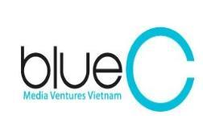
Members of MVV Group
Media Ventures Vietnam consists of many companies in the fields of marketing, communications, technology, education ... We unlock the potential and develop the strengths of our customers to help them reach their highest business goals.
Công ty Cổ phần Mibrand Việt Nam
...
Notes:
1. Công ty Cổ phần Mibrand Việt Nam > Link dẫn về 2.1
2. Công ty Cổ phần Tư vấn truyền thông MVV SnP > Link dẫn về page riêng (Chi tiết slide dưới)
3. Công ty TNHH Hãng Phim Xanh > Link dẫn về page riêng (Chi tiết slide dưới)
4. Công ty Cổ Phần Bond Creative > Link dẫn về page riêng (Chi tiết slide dưới)
5. Công ty Cổ Phần Truyền Thông Digipencil MVV > Link dẫn về page riêng (Chi tiết slide dưới)
6. Công ty Cổ phần Phát triển nội dung Blue C > Link dẫn về page riêng (Chi tiết slide dưới)
7. Công ty Cổ phần Giáo dục MVV > Link dẫn về page riêng (Chi tiết slide dưới)
8. Công ty Cổ phần DigiMed > Link dẫn về page riêng (Chi tiết slide dưới)
4.

Slide 31
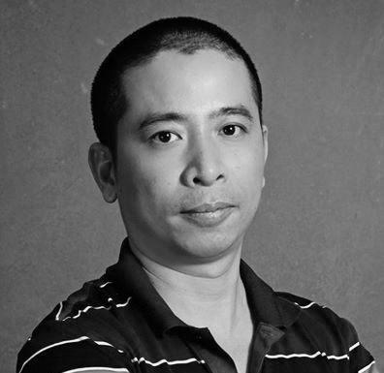
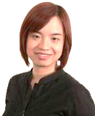

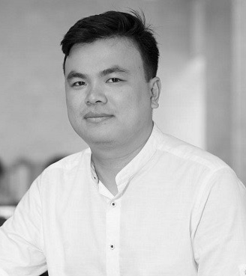
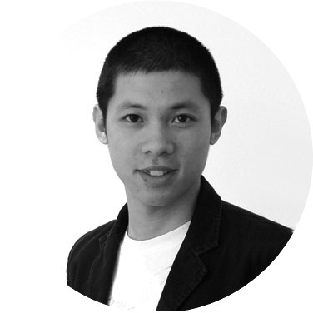
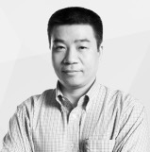
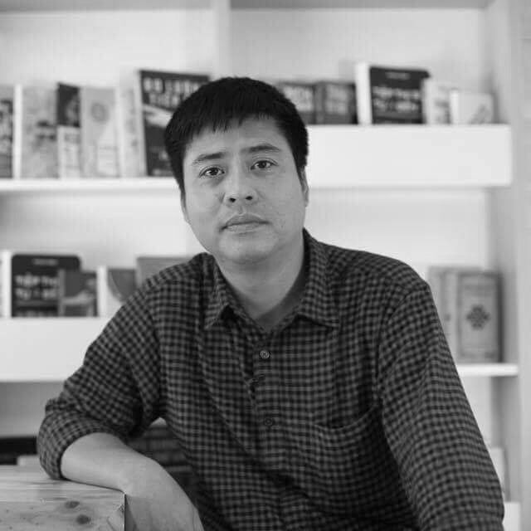
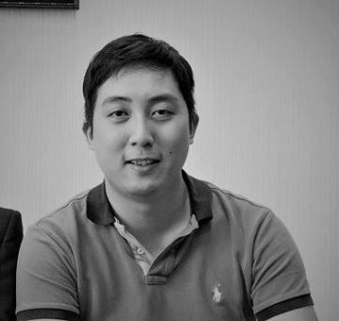
MVV Group’s Leader
Mr. Lại Tiến Mạnh
Ms. Hoàng Chi Phương
Ms. Phạm Hồng Ánh
Mr. Nguyễn Thạch Nguyên
Director of Mibrand
Director of MVV SnP
Director of Blue Production
Director of BOND
Mr. Nguyễn Tiến Huy
Mr. Lê Quang Vũ
Mr. Bùi Đức Quân
Mr. Lê Minh Đức
Director of Digipencil MVV
Director of BlueC
Director of MVV Academy
Director of DigiMed

Slide 32
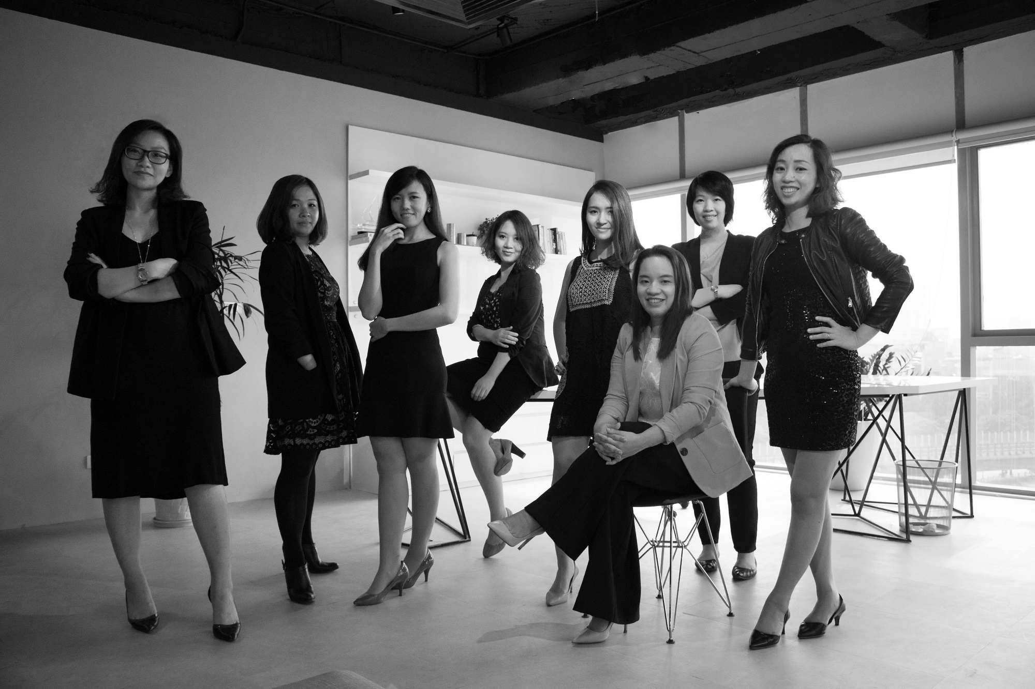
Ms. Hoàng Chi Phương
Ms. Phuong joined T & A Vietnam in 2006 with the position of Group Account Manager. Afterwards, she was appointed as Deputy Director of Business Development for T & A Ogilvy. In 2009, she was promoted to supervise the overall management of T & A Ogilvy, both in business development and customer service.
She has worked on projects including local and regional clients, including AON, Dell, Ford, Kimberly Clark, Tiger Beer, Unilever, UPS ...
Currently, Ms. Hoang Chi Phuong is the managing director of MVV Group's MVV Group. She directly runs projects for MobiFone, MbLand, Inax, Prime, GE Vietnam, AIA, Tupper ware, Iflix, Bao Viet, Vietlott ...
About MVV SnP
Contact:
Formerly known as T & A Communication - one of the first media consulting firms in Vietnam, MVV SNP is the core unit of MVV Group, with the mission of building and strategic planning. MVV SnP identifies customer requirements, develops communication strategies, compatible action plans, and coordinates with other member companies to ensure your brand is constantly evolving., thereby promoting return on investment.
Website: www.mvvsnp.com.vn
Email: contact@mvvsnp.com.vn Hotline: 024.7304.8488
Address:
Hanoi - 8th Floor, 22 Mai Anh Tuan St, Dong Da Dist Ho Chi Minh City - 10th Floor, 151 Vo Thi Sau St, Ward 6, Dist.3

Slide 33

About Blue Productions
Formerly a content creator in T & A Communications, Blue Productions was transformed into a separate production company in 2005 by Mr. Nguyen Thanh Son. Afterwards, the company's management was supported by a team of dynamic and well-known producers and directors, bringing Blue Productions to become one of the leading creative companies in Vietnam.
We specialize in consulting, providing services, building ideas, creativity in the field of film and media based on multimedia platforms.
Contact:
Website: www.bluevietnam.vn
Email: info@bluevietnam.vn Hotline: (+84).48.3822.0814 – (+84).44.2220.6008
Address:
Hanoi - The 3rd Floor, BIDV Building, 194 Tran Quang Khai Street
Ho Chi Minh City - 25/95 Nguyen Binh Khiem Street, Ben Nghe Ward, District 1

Slide 34
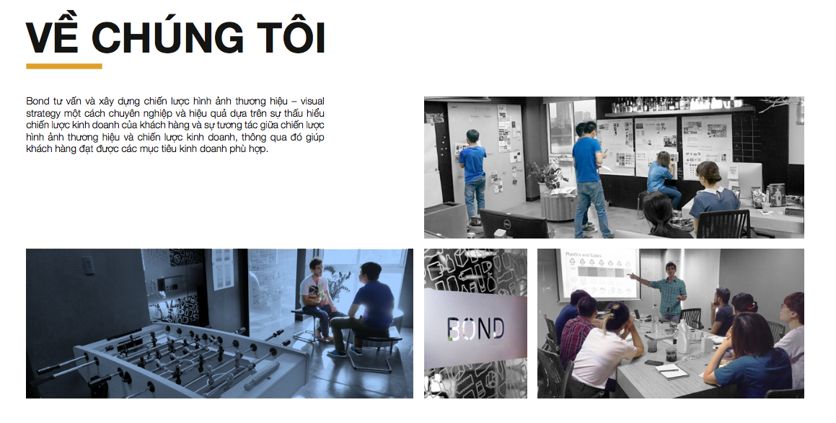
Mr. Nguyen Thach Nguyen
Mr. Nguyen is a Creative director with strategic thinking and excellent customer service skills. He graduated from London University of Economics in Singapore. Before developing Bond Packaging, he held the position of Head of Trade Marketing and Product Development for leading FMCG brands such as Maison Gateaux, Alligator vodka ...
Throughout his journey, he has had the opportunity to meet and work with top-notch specialists in the field who have inspired him in his career and Bond Packaging today.
About BOND Creative
Contact:
Bond Packaging is a pioneer in transforming packaging designs into visual communication and marketing tools.
We combine creativity with market research, linking ideas with customer insights to creating packaging designs and solutions that help customers sell more products. We are not only passionate about design but also expert in material and texture of packaging, graphics and photography. Bond also offers creative ideas and solutions for a wide range of marketing tools, including: POSM, product displays and trade events.
Website: www.bond.com.vn
Email: contact@bond.com.vn Hotline: (+84).932.270.077 - (+84).432.232.777
Address: 9 Floor, Prima building, 22 Mai Anh Tuan, Dong Da, Ha Noi

Slide 35
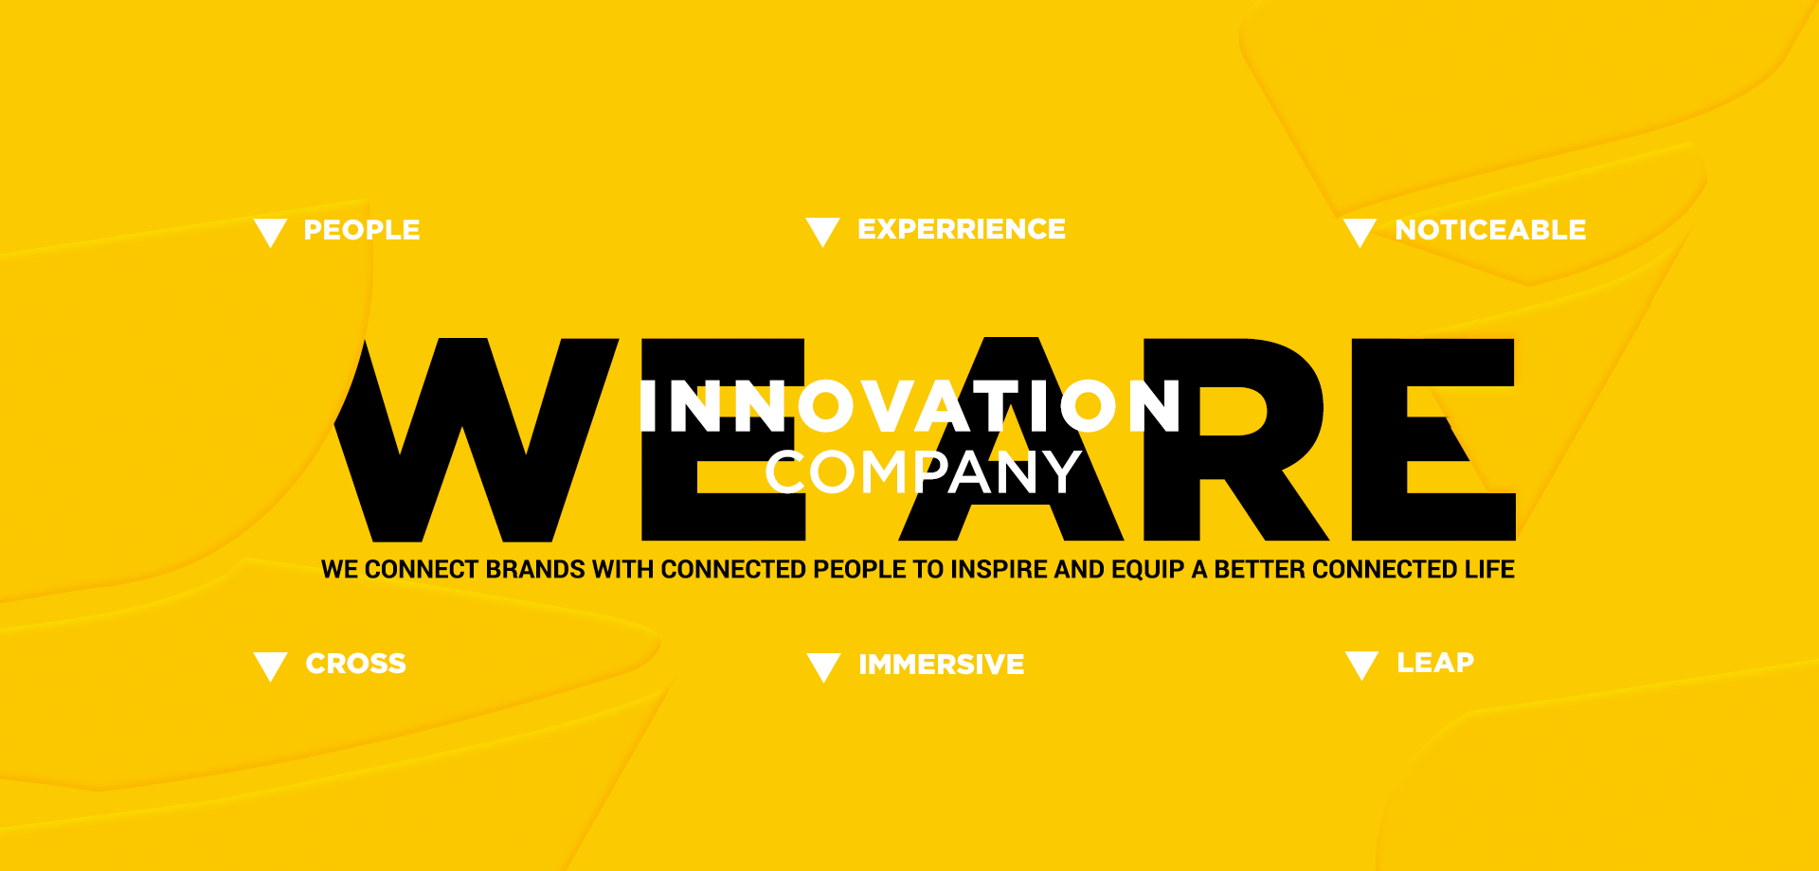
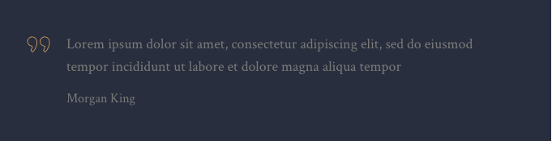
Mr. Nguyen Tien Huy
Mr. Huy has 12 years of experience in the field of digital communications, from software development to advertising and media strategy consulting. He has worked in a variety of roles ranging from project management to creative director and senior consultant before becoming CEO of MVV Digital.
Huy has participated in many domestic and international advertising campaigns for Unilever (Ponds, Dove, Comfort, OMO, Vaseline, Sun- silk, Lux), Nestle, Kimberly Clark, Prudential, Bao Viet Bank, Nokia, Samsung. , ...
Huy is also a well known speaker in the digital media community in HCMC, and is also known as angel investor for Vietnamese startups.
About Digipencil MVV
We are the creative agency of connected age. In the hyper-connected lives, there are so many NEW things shaping NEW human behaviors. Therefore, we learn to understand and capture the NEW connected-insight, filter through the lens of a creative agency to deliver actionable business solutions in a right place, right time, right audience.. DigiPencil provide full services to help brands and organisations to connect with target audience to innovate marketing, operation or distribution activities.
P.E.N.C.I.L Creative Philosophy:
People – Experience – Noticeable – Cross – Immersive – Leap
Our philosophy starts with understand the People. From stakeholder deep insights, we develop 2-way Experience. Our ideas are required to be Noticeable and creative ideas should be able to be executed in multiple platforms, Cross online/offline. We create Immersive experiences with pioneering technologies and always looking at creating Leap, something like a new jump for our clients.
Contact:
Website: www.digipencil.vn
Email: info@digipencil.vn Hotline: (+84).28.3820.62.80
Address: Level 3 – Loyal Office Building, 151 Bis Vo Thi Sau, District 3, HCM City
Digi represents Digital insight and tech, Pencil represents Creativity. The name is DigiPencil
Nguyen Tien Huy – Founder & CEO

Slide 36

Mr. Le Quang Vu
Le Quang Vu is a well known expert with nearly 20 years of experience in the media, journalism, content production and PR.
Vu graduated from the Moscow State Moscow Academy of Journalism (MGIMO) in 1996 with a Master's degree in Public Relations. He is considered content artist, author of many successful content strategy for clients such as VP Bank, VTV, MobiFone ...
About Blue C
Contact:
Blue C is a pioneer in the development of content strategy for businesses and brands. As the first company to provide consulting services and complete internal communications for enterprises.
We pioneered and led the market in providing internal communication strategy solutions for various business models. Blue C helps businesses grow through strengthening their internal strengths.
Website: www.bluec.vn
Email: info@bluec.vn Hotline: (+84).4.7303.2388
Address: 5 Floor, Prima building, 22 Mai Anh Tuan, Dong Da, Ha Noi

Slide 37
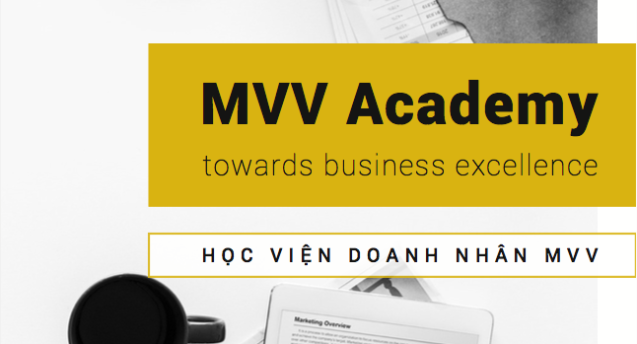
Mr. Bui Đuc Quan
Quan started his career as a salesman at NKK Medical II (ViDeMex II) in Hanoi. He then held many important positions such as Business Director, Assistant Director, Chief of Office ... for many big and famous companies. He is currently the Managing Director of MVV Academy.
Prior to becoming CEO at MVV Edu, Mr. Quan had nearly 10 years of experience in business administration and training. He has been in charge of many important positions such as Assistant to General Director, Sales Director, CEO, etc in many domestic and foreign companies.
From the year 2015, Mr. Quan works as Chief Executive Director at MVV Academy. He is a direct manager of the company's departments, proposing business plans and developing corporate training projects.
Business Institude MVV – MVV Academy
MVV Business Academy is a training organization based on a practical training model that provides solutions to support and enhance internal capabilities for Vietnamese enterprises.
MVV Business Academy is based on three main pillars: 1) L & D Consultant - Training & Development; 2) Provide training support platform applying advanced technology in L & D; 3) Provide training programs from international partners.
The MVV Business Academy Coaching Team is comprised of leading Vietnamese and foreign experts thanks to the strategic partnership between MVV Business Academy and CrossKnowledge (France), Mercuri International (Sweden) and Other leading international education organizations. The mission of the MVV Business Academy is to contribute to enhancing the competitiveness and creating outstanding development for enterprises through the training and development of their own resources.
Contact:
Website: mvvcoaching.edu.vn
Email: info@mvv.edu.vn Hotline: (028).3930.9196
Address: 2 Floor, ITAXA Building, 19 Vo Van Tan, P.6, Q.3, Ho Chi Minh city

Slide 38

Mr. Le Minh Duc
Le Minh Duc is a co-founder and CTO of DigiMed, a technology research and development company, providing solutions and consulting services to companies in many fields such as Mediacl, Education and Communication.
Mr. Le Minh Duc graduated from Nanyang University - Top 12 most prestigious schools in the world. He is a technology specialist involved in building solutions that specialize in business with more than 5 years of experience in leading multinational companies in Singapore such as Delphi Automotive, Nyenburgh and NEC. ...
About DigiMed Vietnam
Contact:
Founded in April 2015, DigiMed is a member of Media Ventures Vienam Group with offices in Hanoi and Ho Chi Minh City. DigiMed is a technology research and development company, providing solutions and consulting services for businesses in many fields, with knowledge and experience in the fields of health, education and marketing.
Our mission is to develop digital solutions / platforms with cloud computing, AI, providing customers with value through simple but powerful products.
Everybody at DigiMed is the problem solver. We all look into each new business as well as the business issues, before giving ideas and solutions to them.
Website: www.digimed.vn
Email: hien.ngo@digimed.vn Hotline: 0962 794 428 (Ms.Hien)
Address: 7th Floor, IC Building, 82 Duy Tan, Cau Giay, Ha Noi

Slide 39
Address:
Telephone:
Working hours:
7th, Prima Building, 22 Mai Anh Tuan, Dong Da dist, Hanoi, Vietnam
(024).7300.5288
Monday – Friday 8:30 – 18:00
We Share
Home
Mibrand Vietnam
Portfolio
Services & Products
We Share
Brand Finance
Contact
We are not just a consulting company, we help find the best solutions to enhance your brand value
Please let us know your email address to receive regular updates from Mibrand Vietnam.
Vui lòng để lại Email của bạn để nhận các thông tin và ưu đãi mới nhất từ Mibrand Vietnam.

Slide 40
2.3 Meet our team

Slide 41

MIBRAND VIETNAM
BRAND FINANCE
CAREERS
CONTACT
GIỚI THIỆU VỀ MIBRAND
PORTFOLIO
SERVICES & PRODUCTS
WE SHARE
Meet our team
Home / Meet our team
Why choose Mibrand?
Mibrand Vietnam is a company specialized in consulting construction and brand management. Mibrand Vietnam's strategic mission is to help customers "increase brand equity."
With a team of experts working in the field of marketing - communication, branding, we promote the application of brand-oriented business model and brand valuation in enterprises.

Slide 42
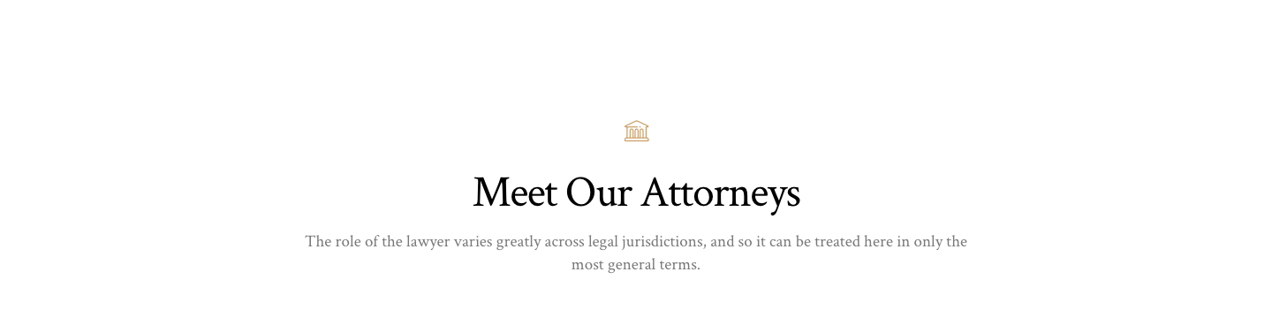
Our experts
With a team of experienced experts in the field of brand consulting and marketing - media master, Mibrand Vietnam is committed to accompany customers on all stages of the brand.
Mr. Lai Tien Manh
Mr. Phung Thai Duong
Managing Director
Deputy Director | Brand Consultant
Mr. Manh is a senior consultant in business solutions, marketing and branding.
He established Mibrand Vietnam Joint Stock Company with the ambition to become the leading brand consultancy company in Vietnam.
Mr. Dương is now a Deputy Director of brand strategy consulting at Mibrand.
With extensive experience in the field of branding, Duong is currently leading the Brand Consultant Team to develop projects for large clients in Mibrand.
Notes:
Mr. Lại Tiến Mạnh: FB - www.facebook.com/manh.lai.7 ; Linkedin - www.linkedin.com/in/lai-tien-manh-90206b13/
Mr. Phùng Thái Dương: FB - https://www.facebook.com/thaiduong.2811 ; Linkedin - www.linkedin.com/in/phungthaiduong/

Slide 43
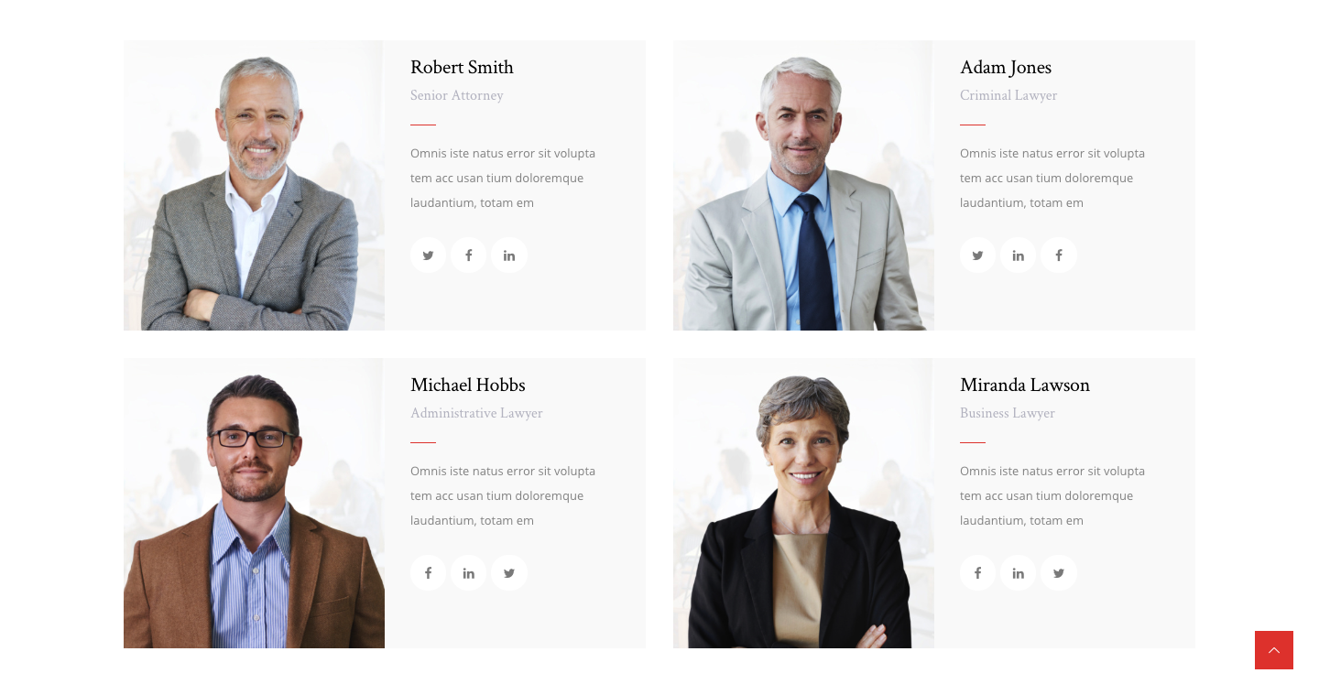
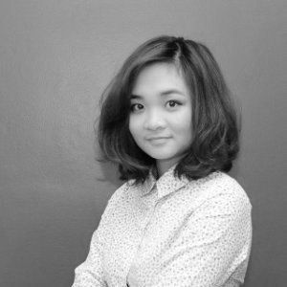
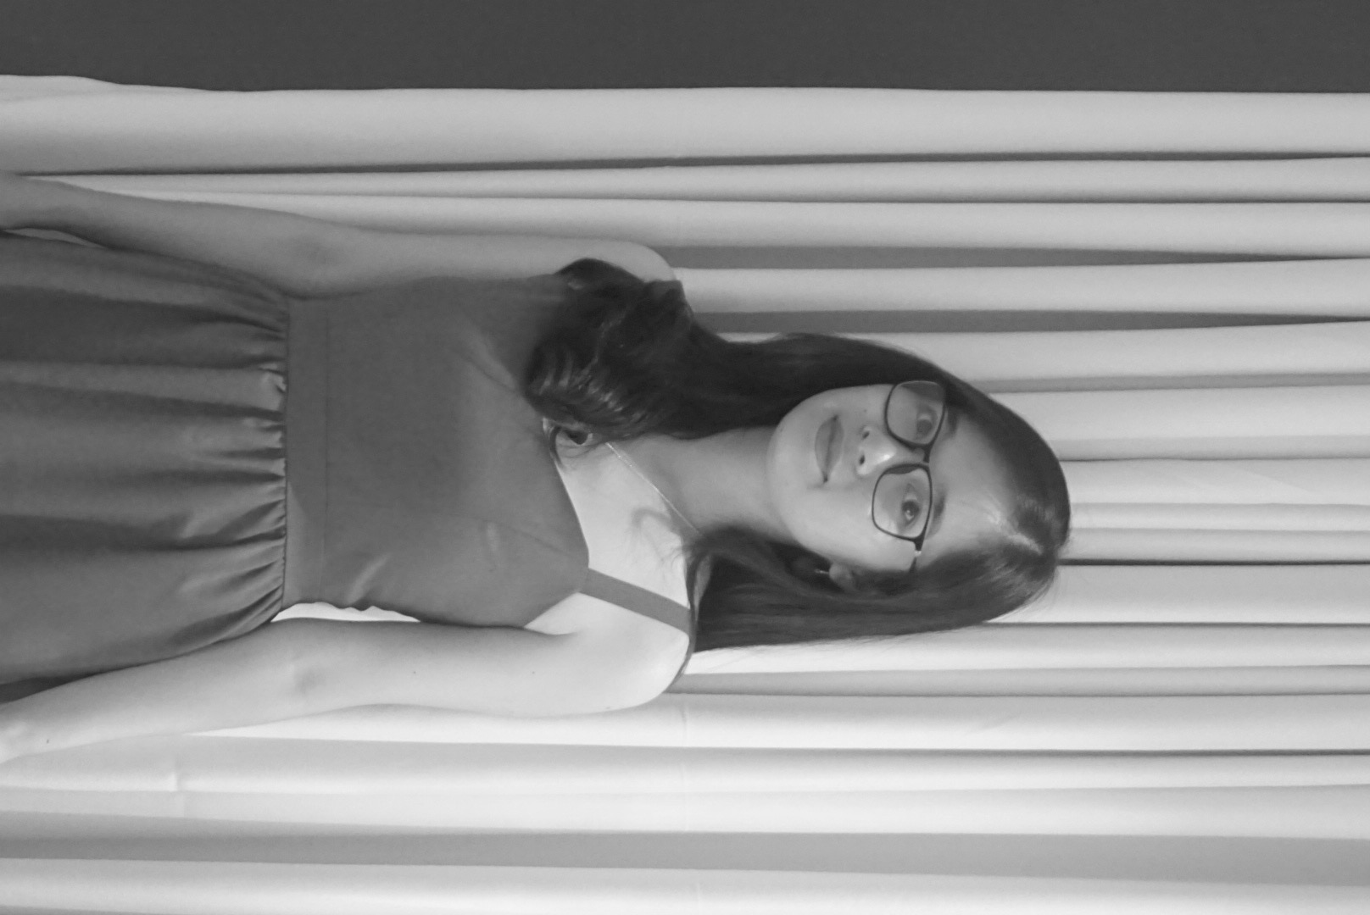
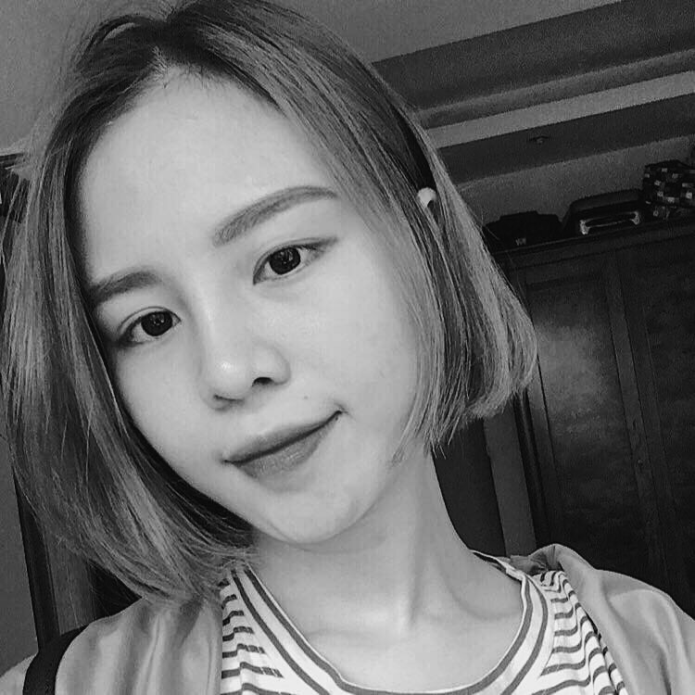
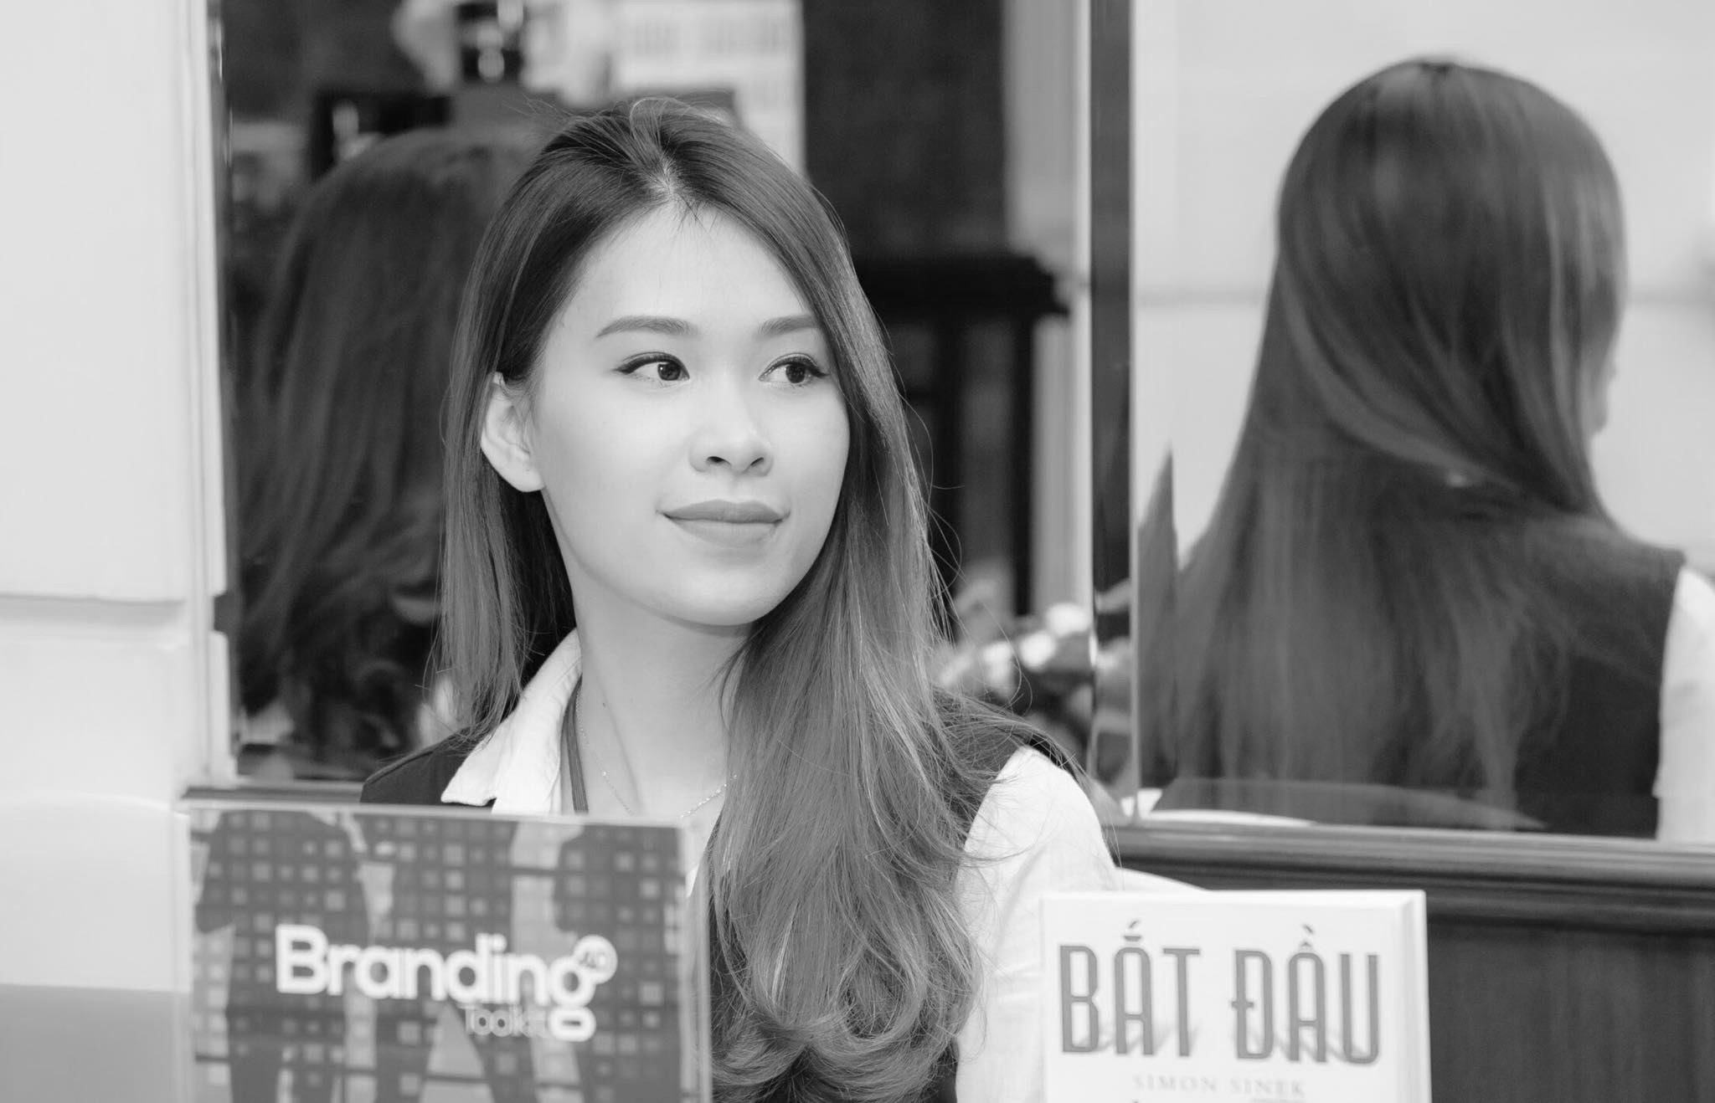
Ms. Nguyen Ngoc Bich
Ms. Pham Nhat Ha
Brand Solutions Manager
Business Unit Manager
Ms. Bich is a Master in International Marketing Management at the University of Leeds, UK.
Bich has 7 years of experience with a starting point at Ogilvy PR Vietnam, then joined a PR agency, now managing the development team at Mibrand Vietnam.
Graduated from Bachelor Degree in Business Administration, Marketing Faculty of Commerce University.
Ms. Pham Nhat Ha has more than 03 years of experience in Marketing, Communications, Branding.
Ms. Dinh Thi Ngoc Lien
Ms. Nguyen Anh Phuong
Creative Design Manager
Account Executive
Graduated from Hanoi Architectural University with a major in graphic design, Ms. Dinh Thi Ngoc Lien has over 3 years of experience with many impressive design products for leading brands in Vietnam. .
Graduated from University of Bedfordshire, UK, she is now working as an Account Executive at Mibrand Vietnam..
Phuong is also responsible for many major projects in market research at Mibrand Vietnam’
Brand Positioning & Development Stategy
Notes:
Ms. Nguyễn Ngọc Bích: FB - https://www.facebook.com/bikfly ; Linkedin – www.linkedin.com/in/bichnguyenngoc/
Ms. Phạm Nhật Hạ: FB - https://www.facebook.com/nhathapham.713?ref=br_rs

Slide 44
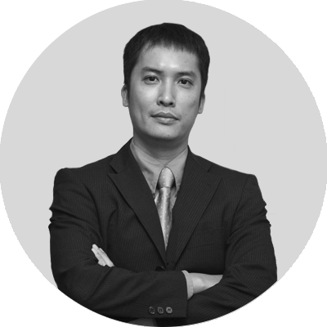
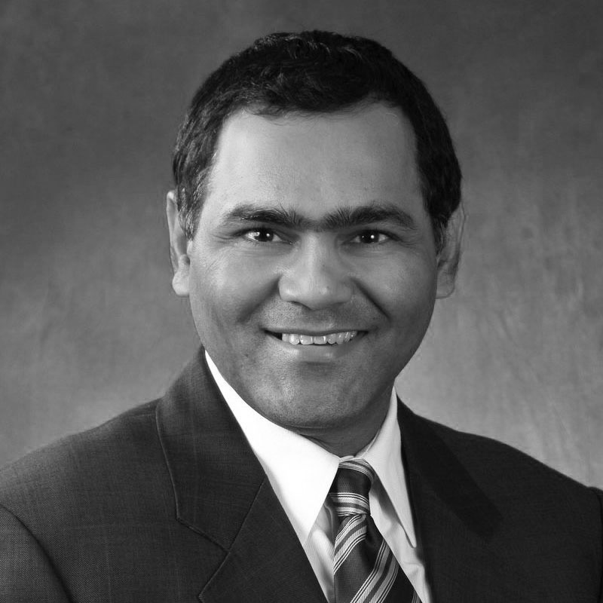
Senior consultant
In large projects, we have the support of media consultants - Brand of international stature. They are the strategic advisors of Mibrand Vietnam
Mr. Nguyen Thanh Son
Mr. Samir Dixit
MVV Group Chairman
Managing Director,
Brand Finance Asia Pacific
Nguyen Thanh Son is one of the most prestigious media experts in Vietnam today.
He was the CEO of T & A Ogilvy in Vietnam. Currently, Mr. Son has more than 10 different companies in the fields of communications, health and education (including leadership, management and investment), including Media Ventures Vietnam Group.
Mr. Samir Dixit is currently Managing Director of Asia-Pacific Brand Finance.
With 20 years of experience in international companies and corporations, Samir Dixit is an experienced global brand manager, M & A brand, brand communications and advertising.

Slide 45
Address:
Telephone:
Working hours:
7th, Prima Building, 22 Mai Anh Tuan, Dong Da dist, Hanoi, Vietnam
(024).7300.5288
Monday – Friday 8:30 – 18:00
We Share
Home
Mibrand Vietnam
Portfolio
Services & Products
We Share
Brand Finance
Contact
We are not just a consulting company, we help find the best solutions to enhance your brand value
Please let us know your email address to receive regular updates from Mibrand Vietnam.
Vui lòng để lại Email của bạn để nhận các thông tin và ưu đãi mới nhất từ Mibrand Vietnam.

Slide 46
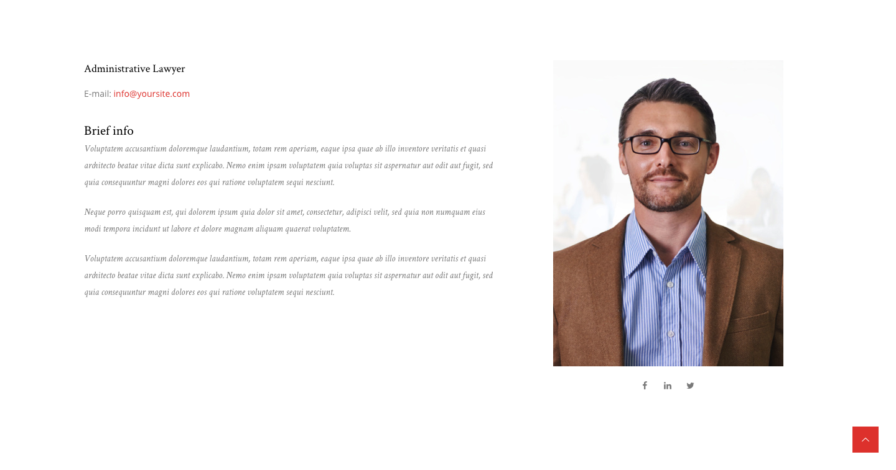
Mr. Lai Tien Manh
E-mail: tienmanh.lai@mibrand.vn
Founder & Managing Director
Mr. Lai Tien Manh is a senior consultant in business solutions, marketing and branding in Vietnam. He has a Masters degree in Marketing in Australia and has over 20 years of experience working with local and international clients.
Mr. Manh's areas of expertise include retailing, consumer goods, industrial goods, cosmetics, furniture, real estate, finance, banking, insurance, technology, healthcare, education. His clients are Tran Anh, BIDV, Sovico, MB, VPBank, BiboMart, HDBank, Elite Fitness, SCG, Hoan My, Yola, MobiFone, Petrovietnam Gas.
Manh has been in charge of developing and executing marketing activities for Coca-Cola and Shell Royal Dutch during its first years in the Vietnamese market. Since 2005, he has worked for T & A Ogilvy as a Strategic Adviser with the establishment and operation of a Business Intelligence Unit.
In 2014, he developed Mibrand Vietnam JSC with the ambition to become the leading brand consultancy company in Vietnam, helping Vietnamese brands develop into multi-billion-dollar brands in the international market
Mibrand is the official representative of Brand Finance in Vietnam - the leading Brand Valuation company in the world, based in the UK.
Notes:
Mr. Lại Tiến Mạnh: FB - www.facebook.com/manh.lai.7 ; Linkedin - www.linkedin.com/in/lai-tien-manh-90206b13/

Slide 47

Mr. Phung Thai Duong
E-mail: thaiduong.phung@mibrand.vn
Deputy Director | Brand Consultant
He studied at the Foreign Trade University in Hanoi and graduated with a Bachelor's degree in Communication and Marketing from the University of Bedfordshire, Luton, UK. Mr. Phung Thai Duong has more than 05 years of experience working in the field of communication and marketing. Starting with the establishment of an agency specializing in brand image consulting and brand identity design for small and medium companies in 2014.
In the process of leading the brand strategy consulting team of Mibrand, Duong has gained valuable experience from participating directly in implementing strategic consulting Branding, Marketing - Communication Integrated for domestic and foreign customers such as Elite Fitness, Viettel, MB Land, TNR Holdings, BIDV, CEO, Yola, Saint Gobain, Bibo Mart, TTC, PTI, PV Gas, Sapharco, GPA, Hoan My , Arctic Milk, PV Combank, VP Bank, Mobifone ...
Currently, as Vice President in charge of brand consulting at Mibrand Vietnam Joint Stock Company, Mr. Phung Thai Duong and a team of experts pioneered in building brand development tools. The purpose is to help businesses to apply various methods of market research, strategic planning, and creative marketing-media content to their own operations.
Duong also assumes the role of trainer on Brand Strategy for Mibrand Vietnam's training and coaching projects and MVV Coaching (MVV Group), to share knowledge on Brand development and management with the trainees who are business owners, communication managers..
Notes:
Mr. Phùng Thái Dương: FB - https://www.facebook.com/thaiduong.2811 ; Linkedin - www.linkedin.com/in/phungthaiduong/

Slide 48
Ms. Nguyen Ngoc Bich
E-mail: bich.nguyen@mibrand.vn
Brand Solutions Manager
Ms. Nguyen Ngoc Bich graduated from Bachelor of Marketing Management at National Economics University. She has 7 years of experience with a starting point working at Ogilvy PR in Vietnam, then joining a PR agency. With the ability, passion and high responsibility, she quickly became Account Manager and strengthened her position in the industry.
Until now, Bich has been in charge of many fields such as Finance and Banking, Automobile, Lifestyle, F & B, NGOs, Public sector, etc. Also during that time, Bich got a Master's degree in International Marketing at Leeds University, UK.
As a person who is enthusiastic and always has a positive energy source, Bich is back in the country and joined Mibrand Vietnam in the role of developing corporate brand solutions, strengthening relationships and finding clients who need to build Brand strategy in Vietnam market.
Bich's goal is to provide effective, practical solutions using Mibrand Vietnam's unique approach to international standards. She defines her career in developing brand solutions for SME's in the context of fierce competition.
Notes:
Ms. Nguyễn Ngọc Bích: FB - https://www.facebook.com/bikfly ; Linkedin – www.linkedin.com/in/bichnguyenngoc/

Slide 49
Ms. Pham Nhat Ha
E-mail: nhatha.pham@mibrand.vn
Business Unit Manager
Graduated from Marketing Faculty of Commerce University in Business Administration, Ms. Pham Nhat Ha has more than 3 years of experience in Marketing, Communications, Branding. Before joining Mibrand in 2017, Ha has held the position of Account Manager at I.P Communication.
In Mibrand Vietnam, Ha is currently in charge of the Business Unit Manager in Brand research. In this role, she pursued a philosophy of building and developing a sustainable brand strategy: going from analyzing customer needs and goals to conducting market research and developing branding strategies that suitable for each specific context.
In the process of working, Ha has experienced in organizing research and participating in strategic consulting projects for big clients such as TTC Group, Mobiphone, Alphafood, Iris English, Yamaha Motor, etc. Medium and small in Vietnam. The experience of working with diverse organizations has led to high-level of strategic thinking about branding and management experience in large-scale research projects.
Currently, Ha and the research team of Mibrand Vietnam is developing the "Brand Beat Score" product, which aims to provide a new research solution to solve the problem of visual communication from the point of end consumer view.

Slide 50
Ms. Dinh Thi Ngoc Lien
E-mail: ngoclien.dinh@mibrand.vn
Creative Desgin Manager
Graduating from the Hanoi Architecture University with a major in Graphic Design, Ms Dinh Thi Ngoc Lien pursued her passion for creative design and branding as soon as she graduated. So far she has had over 3 years of experience with a myriad of impressive design products used by leading brands in Vietnam.
Joining Mibrand Vietnam, Lien has had the opportunity to work and innovate for clients in a variety of industries such as Sapharco, Elite Fitness, BusinessWire, Saint-Gobain, MVV Group, Vinh Tuong, D'Rosie, Alphafood, Sakuko, Nova Land ...
Currently, Lien is the head of creative design at Mibrand with major expertise in brand identity design. The goal of Lien is to update the world brand design trends and develop a brand strategy for modern businesses in Vietnam.

Slide 51
Ms. Nguyen Thi Anh Phuong
E-mail: anhphuong.nguyen@mibrand.vn
Account Executive
Graduated from the Foreign Trade University and got a Master Degree in Marketing from the University of Bedfordshire - UK, Phuong determined her work and development orientation in the field of research and marketing - communicayion from the early days of her career.
Joining Mibrand in 2017 as Account Executive. Beside managing customer service, Phuong is in charge of market research with company's major partners, providing information for risk mitigation, and coordinating the management of project communications. - large integrated marketing with the participation of many parties.
At Mibrand Vietnam, Phuong has had the opportunity to work with big clients such as Yamaha, TTC, Vinatex, OnOff, Elite Fitness, Moc Chau Milk .... Having the eperience in working with large organizations has brought her Strategic thinking in marketing, communication, and practical experience in managing large-scale marketing and communications projects.
Notes:
Ms. Nguyễn Anh Phương: FB - https://www.facebook.com/phuong.ruoi.9 ; Linkedin – https://www.linkedin.com/in/anh-phuong-nguyen-443189160/

Slide 52
Mr. Nguyễn Thanh Sơn
MVV Group Chairman
Senior Consultant – Strategic Adviser
Nguyen Thanh Son is one of the most prestigious media experts today. His main role now is overall planning, coordinating the activities of the research department, developing strategies and innovative services to develop communication strategies and handle crisis communications for Vietnamese and international customers.
Son has been a consultant for brand development and communication strategy for leading brands in Vietnam such as Masan Group, Sovico Group, Tan Hiep Phat Group, Vietnam Airlines, Vinamilk, VNG, MobiFones ... dozens of other international brands, with extensive experience in areas ranging from heavy industry (Boeing, GE, Tata, SCG, Ford) consumer goods (Diageo, Unilever, Nestle, Johnson & Johnson) (Yahoo! Western Digital, Beeline), pharmaceuticals (GSK, Roche) to finance-banking (Standard Chartered Bank, Temasek and Visa) ... Mr. Son is also responsible for advising Vietnam Brand program, and other international organizations such as Danida and USAID.
Mr. Son was the CEO of T & A Ogilvy in Vietnam. Currently, Mr. Son has more than 10 different companies in the fields of media, healthcare, and education (both leadership, management, and investment), in which Media Venture is a group specializing in advertising, media communication, digital content development, technology, content development, graphic design...
Born in Hanoi, Son graduated from the Moscow Institute of International Relations with a Master's degree in International Journalism in 1994. After that, he received his second master's degree in Public Relations from Oklahoma State University. Nguyen Thanh Son also participated in research scholarships from the USIS Business Fellow and the Rockefeller Fellow. He is also a renowned literary critic and expert on multicultural integration, a journalist, and editor for two network magazines. In addition, he has lectured on Asian media and culture at La Trobe University (Australia), Yonsei University (Korea), and Hanoi National University.

Slide 53
Mr. Samir Dixit
Managing Director, Brand Finance Asia Pacific
Senior Consultant – Strategic Adviser
With 20 years of experience in international companies and corporations, Samir Dixit is an expert in global brand management, M & A in branding, brand communications, advertising and more.
Prior to taking over the Asia Pacific as Brand Finance - one of the world's leading brand valuation and strategic consulting firms, Samir Dixit was NFC's Global Brand Director. Standard Chartered Bank. In this position, he manages financial brands from a variety of perspectives, from strategic planning, research / KPIs to internal communications, to brand management.
In addition, he has experience working, B2B strategy consultancy, B2C for many enterprises in many industries, such as FMCG, retail, industrial production, automobile, electricity, beverage medicine, aviation.
Samir Dixit is also a well-known speaker at international conferences on brands in Singapore, Malaysia, Indonesia and Hong Kong.

Slide 54
III. Portfolio

Slide 55

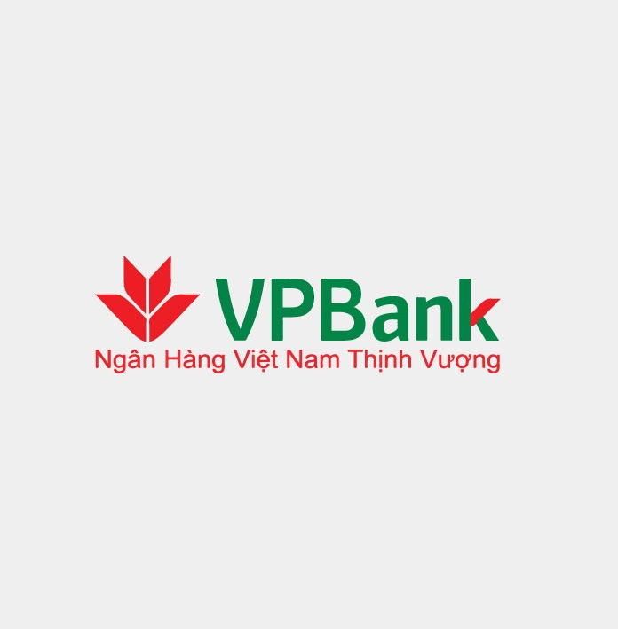

GIỚI THIỆU VỀ MIBRAND
BRAND FINANCE
CONTACT
MIBRAND
VIETNAM
PORTFOLIO
PRODUCTS & SERVICES
WE SHARE
CAREERS
Our success story
Home / Portfolio
Brand positioning & development strategy : Elite Fitness
Brand Identity:
VP Bank
Read more
Read more

Slide 56
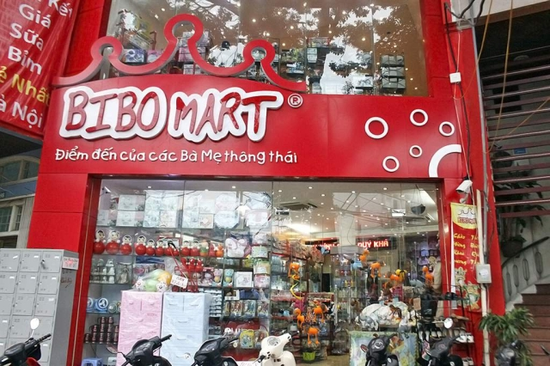
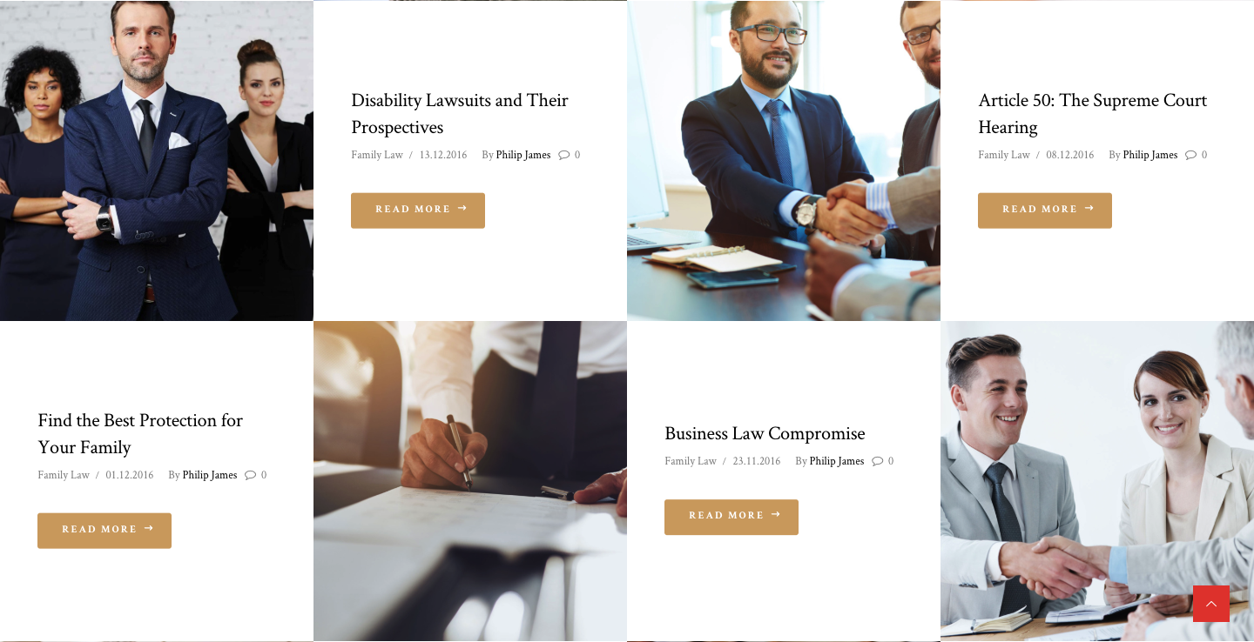
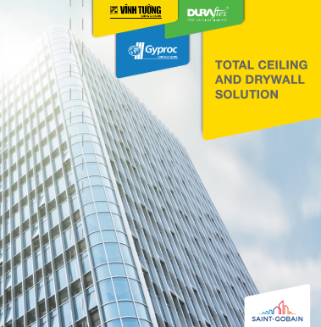


Brand positioning & development strategy : BiboMart
Brand strategy in Vietnam market : Saint-Gobain
Read more
Read more
Brand strategy & integrated communications : Yola
Brand Repositioning & Development Strategy : HD Bank
Read more
Read more

Slide 57

Brand positioning & development strategy : Hoan My
Brand identity and communication strategy : IVB
Read more
Read more
Brand identity: Nhat Cuong Mobile
Brand positioning & development strategy : On Off
Read more
Read more

Slide 58



Intergrated business strategy : PV Gas
Brand positioning and Brand Identity: Tran Anh
Read more
Read more
Store design & customer experience : Mobifone
Brand valuation : TTC Group
Read more
Read more

Slide 59




Marketing and Communication strategy: Moc Chau Milk
Store design and customer experience: Egroup
Read more
Read more
Brand positioning and Development strategy: KIM Dental
Tranfer brand development tools: GPA
Read more
Read more

Slide 60


Transfer Brand positioning tools & Brand development strategy : D'Rosie
Tranfer Brand Development Tools: TNG Group
Read more
Read more

Slide 61
Address:
Telephone:
Working hours:
7th, Prima Building, 22 Mai Anh Tuan, Dong Da dist, Hanoi, Vietnam
(024).7300.5288
Monday – Friday 8:30 – 18:00
We Share
Home
Mibrand Vietnam
Portfolio
Services & Products
We Share
Brand Finance
Contact
We are not just a consulting company, we help find the best solutions to enhance your brand value
Please let us know your email address to receive regular updates from Mibrand Vietnam.
Vui lòng để lại Email của bạn để nhận các thông tin và ưu đãi mới nhất từ Mibrand Vietnam.

Slide 62
IV. Products & Services

Slide 63


GIỚI THIỆU VỀ MIBRAND
BRAND FINANCE
CONTACT
MIBRAND
VIETNAM
PORTFOLIO
PRODUCTS & SERVICES
WE SHARE
CAREERS
Products & Services
Home /Products & Services
Our services
We conduct research, find out the needs and provide solutions for Brand development and specialized Brand management strategy for each customer. Contact us for advice from Mibrand Vietnam experts.

Slide 64
Market research
& Brand Measurement
Brand Strategy Consulting & Implementation
Consulting marketing and communication strategy
Our services
Our services
Our services
We provide research, survey and data analysis services for businesses that wishing to research in the areas of branding, marketing, communications and human resource management.
Our work is to help clients to increase their brand value by integrating brand strategy into their business strategy
.
With the leading experts in the field of marketing - communications, we have developed effective campaigns for many domestic and international clients.
Our products
Mibrand Vietnam is the pioneer in research and development of products that supporting organization in Brand development, management and measurement. Our products help businesses save more time and money compare to the traditional way.
(Button)
Tư vấn & Thực thi chiến lược Thương hiệu > Link dẫn về 4.1
Tư vấn kế hoạch tiếp thị - truyền thông thương hiệu > Link dẫn về 4.1
Nghiên cứu thị trường & Đo lường thương hiệu > Link dẫn về 4.1

Slide 65


BRAND BEAT SCORE
Brand Communication Effectiveness Evaluation Tool
Brand Beat Score was developed based on knowledge gathered from marketing and communication experts - not only to help evaluate the effectiveness of brand communication quickly, but also help businesses understand customers to orient the improvement of communication activities and gradually optimize the brand value in the future.
DOWNLOAD BRAND BEAT SCORE SALEKITS

Slide 66

BRANDING 4.0
Brand positioning and Development Tool
The Branding 4.0 Toolkit was developed by Mibrand Vietnam with the aim to empower the Brand strategic planning into the hands of enterprises under the guidance of the consultants. Branding 4.0 Toolkit leads the way in brand-oriented business development.
DOWNLOAD BRANDING 4.0 SALEKITS

Slide 67
Request a consultation
Mibrand Vietnam will contact you as soon as possible
HD Bank
Chiến lược định vị & phát triển thương hiệu HD Bank
Name:
Email:
Company Name
Tel:
Company name:
Message:
Brand Positioning & Development Stategy
Send message
(Button) GỬI YÊU CẦU > Gửi vào Email: contactus@mibrand.vn

Slide 68
Address:
Telephone:
Working hours:
7th, Prima Building, 22 Mai Anh Tuan, Dong Da dist, Hanoi, Vietnam
(024).7300.5288
Monday – Friday 8:30 – 18:00
We Share
Home
Mibrand Vietnam
Portfolio
Services & Products
We Share
Brand Finance
Contact
We are not just a consulting company, we help find the best solutions to enhance your brand value
Please let us know your email address to receive regular updates from Mibrand Vietnam.
Vui lòng để lại Email của bạn để nhận các thông tin và ưu đãi mới nhất từ Mibrand Vietnam.

Slide 69
4.1 Brand consulting service

Slide 70

GIỚI THIỆU VỀ MIBRAND
BRAND FINANCE
CONTACT
MIBRAND
VIETNAM
PORTFOLIO
PRODUCTS & SERVICES
WE SHARE
CAREERS
Mibrand Vietnam’s Brand consulting service
Home / Products & Services / Our services
Overview of Brand Strategy consulting and implementation capacity of Mibrand Vietnam
Mibrand Vietnam aims to become the leading company providing consulting services for construction and brand management in Vietnam. At Mibrand, we believe that: Brand-driven business is the solution to help businesses build a competitive advantage in the market.
We conduct research, find out the needs and provide customized brand development consulting and brand management solutions for each client we work with.

Slide 71


Slide 72


Slide 73
Our method
With more than 20 years of experience in the field of marketing communication and branding, we have accumulated many lessons and promoted the research and development of specialized tools. All of them are intended to help businesses solve specific problems in each stage of development.
BRAND RESEARCH
BRAND POSITIONING
BRAND ARCHITECTURE
BRAND DEVELOPMENT
BRAND IDENTITY
BUILDING CAPABILITIES
BRAND COMMUNICATION
BRAND MEASUREMENT
Brand Context Research
Brand Company Research
Brand Competitor Research
Brand Customer Insight Research
Brand Positioning Statement
Brand Positioning Essence
Brand Positioning Manifesto
Brand Positioning Scale
Brand Positioning Matrix
Brand Core
Branded House
Subs-Brands
Endoresd Brands
House of Brand
Brand Customer Experience Management
Brand Product Development
Brand Culture Platform
Brand Internal Development
Brand Distribution Strategy
Brand Logo & Logo Guideline
Brand Identity – Corporate Identity
Brand Image Guideline Systems
Brand Marcom Design
Brand Product Packaging Design
Brand Positioning Kick-off Workshop
Brand Operational Processes Development
Standardize Brand Service Standards
Brand & Marcom Coaching programs
Sales & Distribution Coaching programs
Brand Big Idea
Brand Marketing & Communication House
Brand IMC Model & Planning
Brand Beat Score
Brand Health Check
Brand Employee Satisfaction Survey
Brand Valuation

Slide 74
Address:
Telephone:
Working hours:
7th, Prima Building, 22 Mai Anh Tuan, Dong Da dist, Hanoi, Vietnam
(024).7300.5288
Monday – Friday 8:30 – 18:00
We Share
Home
Mibrand Vietnam
Portfolio
Services & Products
We Share
Brand Finance
Contact
We are not just a consulting company, we help find the best solutions to enhance your brand value
Please let us know your email address to receive regular updates from Mibrand Vietnam.
Vui lòng để lại Email của bạn để nhận các thông tin và ưu đãi mới nhất từ Mibrand Vietnam.

Slide 75
V. We Share

Slide 76




GIỚI THIỆU VỀ MIBRAND
BRAND FINANCE
CONTACT
MIBRAND
VIETNAM
PORTFOLIO
PRODUCTS & SERVICES
WE SHARE
CAREERS
Mibrand - We Share
Home / We Share
Positioning: The journey to find the soul for the brand
Corporate culture: Endogenous resources of the brand
04 Brand Story You Should Tell

Slide 77

Positioning: The journey to find the soul for the brand
Corporate culture: Endogenous resources of the brand
04 Brand Story You Should Tell
We Share / 08.05.2018
Phùng Thái Dương
We Share / 21.06.2018
Phùng Thái Dương
Brand positioning is a way to find the soul of the brand. Having a good brand positioning strategy will help you identify the long-term development path. One of the best examples of "positioning" is the story in "Alice in Wonderland." Alice gets lost and asks his cat. He asked her where she wanted to go. Alice did not know where to go. The cat said to her, "If you do not know where you are going, every way is the same…
We Share / 11.05.2018
Phùng Thái Dương
Many researches over time have demonstrated the effectiveness, practicality and necessity of "storytelling" in marketing. In a survey, 92% of consumers said they tend to absorb things they read more easily in the form of a story. In simple words, compelling stories help people connect and remember more deeply what they have read (or seen or heard).
In fact, for storytellers, even an amateur is better at conveying the story of his brand than a high-paying advertising executive. ..
Branding, today, plays a crucial role in the development of a business. When it comes to branding, people often think of the economic, legal, marketing or industrial arts aspects ... but not much about the cultural aspects of the brand. Most organizations neglect the importance of developing a strong brand culture before exchanging their value with the outside world. Managers from these companies do not understand that they can hardly expect their employees to deliver a consistent brand experience for their customers while their employees are not provided with a clear culture of branding. ...
Notes:
Link bài 1: https://www.facebook.com/mibrandvietnam/posts/1716095265138188
Link bài 2: https://www.facebook.com/mibrandvietnam/posts/1717932144954500
Link bài 3: https://www.facebook.com/mibrandvietnam/posts/1763018720445842

Slide 78



Brand positioning for the medical industry
Marketing Communications Trends 2018
Strategic branding in Vietnam 2018 (P1): Brand positioning 4.0
We Share / 01.07.2018
Lại Tiến Mạnh
We Share / 08.02.2018
Phùng Thái Dương
The boundaries between pharmaceutical, cosmetic, medicine or functional foods are quite fragile for most consumers. How to choose the brand name of the product, choose what personality brand and put it into the frame of reference is chosen by the brand ...
We Share / 11.01.2018
Nguyễn Thanh Sơn
Today, people evaluate the success or failure of corporate brands based on their relationship with the employees, the experience they bring to the customer, and the influence from the business. Points and their behavior to the community, society. Therefore, brand positioning in 2018 is completely different from the brand positioning of the 1980s, 2000s or 2010. So what do we need to pay attention to?
n 2018, the trends of marketing communications in Vietnam continue to be affected by the changing media, marketing and change of Vietnam, all of which can be summarized in one word - meaning (re-define).
Notes:
Link bài 1: https://www.facebook.com/notes/l%E1%BA%A1i-ti%E1%BA%BFn-m%E1%BA%A1nh/%C4%91%E1%BB%8Bnh-v%E1%BB%8B-th%C6%B0%C6%A1ng-hi%E1%BB%87u-cho-ng%C3%A0nh-d%C6%B0%E1%BB%A3c/10156404950924477/
Link bài 2: http://www.brandsvietnam.com/14476-Xu-huong-truyen-thong-tiep-thi-2018
Link bài 3: https://brandfield.com.vn/chuoi-bai-ve-cac-xu-huong-chien-luoc-thuong-hieu-viet-nam-2018-phan-1-dinh-vi-thuong-hieu-4-0/

Slide 79



Brand Strategy Trends Vietnam 2018 (P2): Personality brand
Brand Strategy Trends Vietnam 2018 (P3): Internal Specialist
Strategic branding in Vietnam 2018 (P4): Effective communication
We Share / 08.02.2018
Phùng Thái Dương
We Share / 08.02.2018
Phùng Thái Dương
The boundaries between pharmaceutical, cosmetic, medicine or functional foods are quite fragile for most consumers. How to choose the brand name of the product, choose what personality brand and put it into the frame of reference is chosen by the brand ...
We Share / 08.02.2018
Phùng Thái Dương
Today, people evaluate the success or failure of corporate brands based on their relationship with the employees, the experience they bring to the customer, and the influence from the business. Points and their behavior to the community, society. Therefore, brand positioning in 2018 is completely different from brand positioning of the 1980s, 2000s or 2010. So what do we need to pay attention to?
In 2018, the trends of marketing communications in Vietnam continue to be affected by the changing media, marketing and change of Vietnam, all of which can be summarized in one word - meaning (re-define).
Notes:
Link bài 1: https://brandfield.com.vn/chuoi-bai-ve-cac-xu-huong-chien-luoc-thuong-hieu-viet-nam-2018-phan-2-nhan-cach-hoa-thuong-hieu/
Link bài 2: https://brandfield.com.vn/chuoi-bai-ve-cac-xu-huong-chien-luoc-thuong-hieu-viet-nam-2018-phan-3-xay-dung-doi-ngu-cac-chuyen-gia-thuong-hieu-noi-bo-in-house/
Link bài 3: https://brandfield.com.vn/chuoi-bai-ve-cac-xu-huong-chien-luoc-thuong-hieu-viet-nam-2018-phan-4-danh-gia-hieu-qua-hoat-dong-truyen-thong-thuong-hieu/

Slide 80
Address:
Telephone:
Working hours:
7th, Prima Building, 22 Mai Anh Tuan, Dong Da dist, Hanoi, Vietnam
(024).7300.5288
Monday – Friday 8:30 – 18:00
We Share
Home
Mibrand Vietnam
Portfolio
Services & Products
We Share
Brand Finance
Contact
We are not just a consulting company, we help find the best solutions to enhance your brand value
Please let us know your email address to receive regular updates from Mibrand Vietnam.
Vui lòng để lại Email của bạn để nhận các thông tin và ưu đãi mới nhất từ Mibrand Vietnam.

Slide 81
VI. Brand Finance

Slide 82


GIỚI THIỆU VỀ MIBRAND
BRAND FINANCE
CAREERS
CONTACT
MIBRAND VIETNAM
PORTFOLIO
PRODUCTS & SERVICES
WE SHARE
Brand Finance
Home / Brand Finance
Brand Finance: The world's leading brand valuation company
Mibrand Vietnam is a strategic partner and official representative in Vietnam of Brand Finance (UK) - one of the three leading brand valuers in the world in more than 20 countries.
Each year, Brand Finance valuates about 3,500 brands. With prestigious and specialized charts for many countries and areas, Brand Finance's valuation results are recognized worldwide.
BRAND FINANCE
(Button) VỀ BRAND FINANCE > Dẫn link đến website: http://brandfinance.com/

Slide 83

Top 50 Vietnam Brand in 2017 Report
Mibrand Vietnam has partnered with Brand Finance to announce the list of Top 50 Most Valuable Brands in Vietnam in 2015, 2016 and 2017. These are also the first time that Vietnamese brands have been evaluated by Brand Finance.
DOWNLOAD PDF +

Slide 84


Top 50 Vietnam Brand in 2015 Report
Top 50 Vietnam Brand in 2016 Report
DOWNLOAD PDF +
Frequently Asked Questions
DOWNLOAD PDF +

Slide 85

Valuate your brand with Mibrand Vietnam and Brand Finance
Learn more about brand valuation with Mibrand Vietnam and Brand Finance by leaving a message and sending a request today.
HD Bank
Chiến lược định vị & phát triển thương hiệu HD Bank
Name:
Email:
Telephone:
Name of company:
Message:
Brand Positioning & Development Stategy
SEND MESSAGE
(Button) GỬI YÊU CẦU > Gửi vào Email: contactus@mibrand.vn

Slide 86
Address:
Telephone:
Working hours:
7th, Prima Building, 22 Mai Anh Tuan, Dong Da dist, Hanoi, Vietnam
(024).7300.5288
Monday – Friday 8:30 – 18:00
We Share
Home
Mibrand Vietnam
Portfolio
Services & Products
We Share
Brand Finance
Contact
We are not just a consulting company, we help find the best solutions to enhance your brand value
Please let us know your email address to receive regular updates from Mibrand Vietnam.
Vui lòng để lại Email của bạn để nhận các thông tin và ưu đãi mới nhất từ Mibrand Vietnam.

Slide 87
VII. CAREERS

Slide 88

GIỚI THIỆU VỀ MIBRAND
BRAND FINANCE
CONTACT
MIBRAND
VIETNAM
PORTFOLIO
PRODUCTS & SERVICES
WE SHARE
CAREERS
Career in Mibrand Vietnam
Home / Careers
For branding enthusiasts
We extend the opportunity to educate and build a clear career path for all positions, encouraging people to explore themselves in new areas - whether it is research, counseling , creative content creation, or training projects. At Mibrand, we work hard to create passion and build the best working environment.

Slide 89


ACCOUNT EXECUTIVE
Job Description
...
BRAND CONSULTANT
Job Description
...
DIGITAL MARKETING
Job Description
...
SALES EXECUTIVE
Job Description
...
PROJECT EXECUTIVE & MANAGER
Job Description
...
ACCOUNT EXECUTIVE INTERN
Job Description
...

Slide 90
Address:
Telephone:
Working hours:
7th, Prima Building, 22 Mai Anh Tuan, Dong Da dist, Hanoi, Vietnam
(024).7300.5288
Monday – Friday 8:30 – 18:00
We Share
Home
Mibrand Vietnam
Portfolio
Services & Products
We Share
Brand Finance
Contact
We are not just a consulting company, we help find the best solutions to enhance your brand value
Please let us know your email address to receive regular updates from Mibrand Vietnam.
Vui lòng để lại Email của bạn để nhận các thông tin và ưu đãi mới nhất từ Mibrand Vietnam.

Slide 91
Account Executive
Trang chủ / Tuyển dụng / Account Executive
Job Description
ACCOUNT EXECUTIVE
Salary: Negotiable
Career Level: Executive - Fulltime
Working Time: 8.30am – 6.00pm, Mon – Fri
Account Executive has the ability and experience in business development and branding consultancy skills; has the ability and experience to play an implementation role in client work. He/she must have a good understanding about integrated communications, including Public relations, ABL and BTL Brand activations, Productions, be able to handle direct client contact and have the potential to become a good program developer, presenter and counselor.
Responsibilities:
Is fully familiar with receiving briefing, developing proposal, delivering presentations.
Responsible for day-to-day client servicing of assigned accounts & projects; Follow up their inquires and give instruction to Brand Associate on details; Prepare contracts, bidding process.
Acts as a liaison between client, suppliers and, other internal and external audiences.
In charge consulting work which may include: research process such as preparing research details, research questionaire, suggest research methodology, conduct research (desk research, in-depth interview, focus group..), preparing research report.
Develop brand strategy (brand positioning, brand development), create core brand identity (brand name, logo, slogan, branding materials and applications), develop brand communication plan.
Exploring potential leads and contribute contents to company’s website.
Applies knowledge of the full range of resources available throughout the company.
Cooperate with other team, other offices and other company components.
Professional Skills:
Writing skills on pitching proposal, research report and branding proposal.
Perform good project management skills.
Be able to conceptualize and produces communication programs.
Knowledge of graphics, creative concept & idea.
Demonstrate problem solving and result oriented working attitude.
Demonstrates proficiency in managing agency and client resources: people, time and money.
Benefits:
Net salary and compulsory schemes of social, health insurance and unemployment insurance
Health care policy included AON health insurance and annual medical examination
Company incentive trip and Group year-end vacation
Training course and cross-training workshops among companies of Media Ventures Vietnam.
Send your Portfolio:
Mr.Phung Thai Duong – Mibrand Deputy Director
Email: thaiduong.phung@mibrand.vn

Slide 92
Brand Consultant
Trang chủ / Tuyển dụng / Account Executive
Job Description
BRAND CONSULTANT
Salary: Negotiable
Career Level: Executive - Fulltime
Working Time: 8.30am – 6.00pm, Mon – Fri
Brand Consultant should be able to handle consultant projects independently.
Concept – A Brand Consultant has the ability and experience in business development and branding consultancy skills. He/she should perform different skills as presentation, customer relation, project management and will be in charge of customer consulting works. There is no time limit on the Brand Consultant position.
Responsibilities:
In charge consulting work which may include: research process such as preparing research details, research questionaire, suggest research methodology, conduct research (desk research, in-depth interview, focus group..), preparing research report.
Develop brand strategy (brand positioning, brand development), create core brand identity (brand name, logo, slogan, branding materials and applications), develop brand communication plan independently.
Interface directly with client in daily project management and give instruction to Brand Associate on details. Follow up with different clients, managing projects performed with and by others and supervising Brand Associate.
Is fully familiar with receiving briefing, developing proposal, delivering presentations.
Acts as a liaison between client, suppliers and, other internal and external audiences.
Exploring potential leads and contribute contents to company’s website.
Applies knowledge of the full range of resources available throughout the company.
Cooperate with other team, other offices and other company components.
Professional Skills:
Writing skills on pitching proposal, research report and branding proposal.
Perform good project management skills.
Be able to conceptualize and produces communication programs.
Knowledge of graphics, creative concept & idea.
Demonstrate problem solving and result oriented working attitude.
Demonstrates proficiency in managing agency and client resources: people, time and money.
Benefits:
Net salary and compulsory schemes of social, health insurance and unemployment insurance
Health care policy included AON health insurance and annual medical examination
Company incentive trip and Group year-end vacation
Training course and cross-training workshops among companies of Media Ventures Vietnam.
Send your Portfolio:
Mr.Phung Thai Duong – Mibrand Deputy Director
Email: thaiduong.phung@mibrand.vn

Slide 93
VIII. Contact

Slide 94

GIỚI THIỆU VỀ MIBRAND
BRAND FINANCE
CONTACT
MIBRAND
VIETNAM
PORTFOLIO
PRODUCTS & SERVICES
WE SHARE
CAREERS
Contact
Home / Contact
Address:
Hotline:
Working hours:
7th floor, Prima Building, 22 Mai Anh Tuan Street, Dong Da dist, Hanoi, Vietnam
(024).7300.5288
8:30 – 18:00, Mon - Fri

Slide 95

Contact
Send us E-mail and your request.
Mibrand Vietnam will contact you as soon as possible. We offer free consultations with clients to find out their problems.

Slide 96


Slide 97
We Share
Trang chủ
Về Mibrand Vietnam
Hồ sơ năng lực
Sản phẩm & Dịch vụ
We Share
Về Brand Finance
Liên hệ
We are not just a consulting company, we help find the best solutions to enhance your brand value.
Please let us know your email address to receive regular updates from Mibrand Vietnam.
Vui lòng để lại Email của bạn để nhận các thông tin và ưu đãi mới nhất từ Mibrand Vietnam.

Slide 98
End

